Slide 1
Virtual practical workshop Cooking on a budget: Healthy, affordable dishes
19 November 2022

Slide 2

Housekeeping and overview
Good food hygiene and safety practices - are you ready to cook?
Long hair tied up.
Jumpers removed/long sleeves rolled up.
Nail varnish and jewellery/watches removed.
Thoroughly washed and dried hands.
Clean apron on.
Turn off mobile phone (pop on vibrate)
You should have all your equipment and ingredients ready/handy
Get ready to cook!
Chat box – feel free to use to ask questions and share info/links and ideas
Camera on – we want to see your food skills
Help and direction (please don’t take as criticism!)
Feel free to ask questions and engage!
Feedback – it’s good to get your views!
Tweet or post on Facebook!
Enjoy!
@foodafactoflife

Slide 3
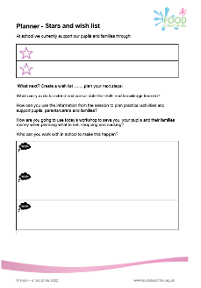
Session aims
Make a plan!
Fill out the action plan during the session.
Hear top tips to save you, your pupils and their families money when planning what to eat, shopping and cooking.
Make three recipes, with different learning intents, a range of practical food skills and different cooking methods/equipment used.
Through the recipes and ingredients, pupil progression and how to plan and manage practical activities in the classroom will also be covered.
Have an opportunity to share what you are doing and learn from other teachers.
Highlight support resources from Food – a fact of life.

Slide 4
Programme
08.45 Registration
09.00 Welcome:
Tips for saving money when planning what to eat, shopping and cooking;
09.20 Demonstration - Pork meatballs with cheesy crumb topping
09.40 Activity - Pork meatballs with cheesy crumb topping making
10.15 Recap and review
10.25 Demonstration – Mexican pockets
10.35 Activity – Mexican pockets making
11.00 Recap and review
11.10 Comfort break
11.20 Demonstration - Super soup and speedy flatbreads
11.30 Activity - Super soup and speed flatbreads making
12.00 Recap and review
12.10 Session review and next steps
12.30 Finish – Evaluation and certificate

Slide 5






Introduction: the facts
“Food insecurity (sometimes referred to as food poverty) is the state of being without reliable access to a sufficient quantity of affordable, nutritious food.” (Food Foundation, 2022)
1 in 6
UK adults used a food bank in March 2022
Source: FSA, 7 June 2022
9%
Increase in the cost of supermarket food between April 2021 and April 2022
2.6 million children
Source: FSA, 7 June 2022
13.8% of households
Children (22.5%) are eligible for free school meals, an increase from 1.74 million (20.8%) in January 2021
7.3 million adults
Source: ONS, 9 June 2022
Source: Food Foundation Food Insecurity Tracker, April 2022 (n=10,674 Adults 18+ years
1.9 million

Slide 6


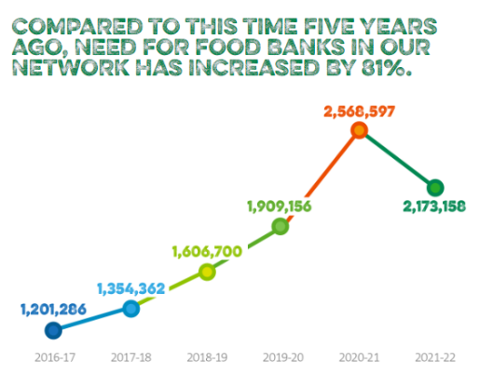
Introduction: the facts
Between 1 April 2021 and 31 March 2022, food banks in the Trussell Trust’s UK wide network distributed over 2.1 million emergency food parcels to people in crisis.
This is an increase of 14% compared to the same period in 2019/20. 832,000 of these parcels went to children.
https://www.trusselltrust.org

Slide 7
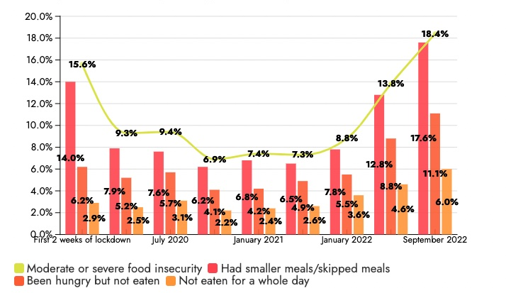
Introduction: the facts
A total of 9.7 million adults experienced food insecurity in September 2022, the Food Foundation reports. Over half (53.8 per cent) of universal credit claimants faced food poverty in the last month.
Graph source: The Food Foundation

Slide 8
Working on a budget – at home and school
Context:
The cost of living has gone up. Many will be affected by the rise in food, energy and fuel prices.
Surveys report that the concern about the rising costs of living is linked with spending less on food shopping and essentials.
With more people living on tight budgets, eating a healthy, balanced diet can be challenging.
Guidance and support:
The aim is to support pupils and families to become aware of ways in which they can cook healthy, nutritious food on a limited budget.
To support food education teachers and trainers in planning and providing lessons on more limited budgets.
Notes:
Interesting and informative articles:
https://www.bigissue.com/news/social-justice/food-poverty-in-the-uk-the-causes-figures-and-solutions/

Slide 9
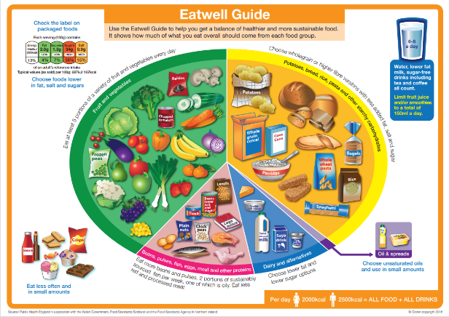
Eating well
These eight practical tips cover the basics of healthy eating and can help you make healthier choices.
Base your meals on starchy carbohydrates
Eat lots of fruit and veg
Eat more fish – including a portion of oily fish
4. Cut down on saturated fat and sugar
5. Eat less salt
6. Get active and be a healthy weight
7. Don’t get thirsty
8. Don’t skip breakfast
Notes:
How many grams do you think is a portion? About palm size
Examples of wholegrains – with every meal
Portion examples:
2 handfuls of dried pasta shapes or rice (75g);
A bunch of spaghetti the size of a £1 coin, measured using your finger and thumb (75g);
A baked potato about the size of your fist (220g);
About 3 handfuls of breakfast cereal (40g).
Protein - How much? – give examples throughout the day
Dairy - Examples with meals – what is a portion?
Portions: A piece of cheddar cheese about the size of two thumbs together (30g).

Slide 10
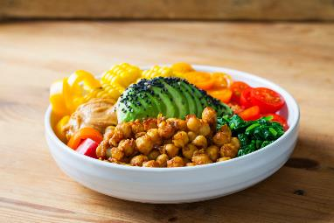
Sustainable choices
In 2021 The British Nutrition Foundation conducted a review of recent research literature to find identify the main principles of a healthier and more sustainable diet. The six recommendations for a healthy, sustainable diet, based on the review are:
  follow the Eatwell Guide;
  eat more fruit and vegetables;
  diversify protein sources;
  limit foods high in fat, salt or sugar;
  choose sustainable fish and seafood;
  waste less food.
Notes:
Sustainable choices – aim for - healthy, affordable and accessible diet for everyone, and also have a lower impact on the environment
Animal foods provide high-quality protein and essential vitamins and minerals, such as calcium, iron, zinc, iodine and vitamin B12 often in a form that is easier to absorb and use.
Evidence suggests that it is not necessary to cut out meat or other animal source foods from our diet to be more sustainable.
But, we should also aim to expand our choice of protein-containing foods to include more plant-derived sources, such as beans and other pulses, nuts, seeds, and plant-based meat alternatives, for example those based on pulses such as soya or on mycoprotein, provided they are not high in saturated fat or salt.

Slide 11
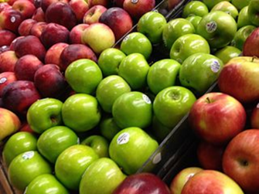
Seasonality
Eating seasonally means eating food that's naturally ripe and ready for harvest in your local area at the time.
Benefits:
It saves money – less cost to grow/transport
It tastes better – less travelling time
Nutrients - produce is more nutrient-rich right after being harvested.
Supports local community – buying local food supports local producers
More environmentally-friendly and sustainable - eating seasonally reduces the energy (and associated CO2 emissions) needed to grow and transport produce.
Notes:
Money - when produce is out of season in your area, they either have to be grown in managed conditions or transported from the other side of the world. Costs are passed on to the consumer.
Taste - Seasonal produce comes such a short distance that it doesn’t spoil on the way. It’s harvested at the very best time, so taste is maximised. Importing means produce needs to be picked early and left to mature in cargo holds and storage containers
Nutrient rich - nutrient content of fruits and vegetables varies according to season, climate and level of ripeness. However, it has been shown that produce is more nutrient-rich right after being harvested.
Consuming frozen and tinned fruit and vegetables is way of including a bigger variety of plants in the diet, as these can be stored for a long period of time and consumed out of season.
Apples – good discussion point: local grown v imports.

Slide 12
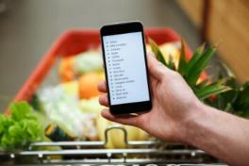
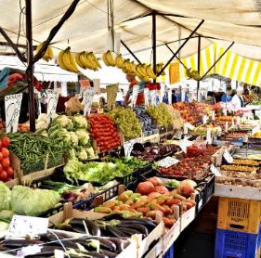
Shopping – top tips
Planning meals ahead and writing a shopping list before going shopping – check what is in store cupboards/freezer.
Look for special offers on long shelf-life products like dried pasta, dried or canned beans and pulses, buying in 'bulk' can be cheaper. Check value for money.
Shop at the right time – avoid when you are hungry, it’s tempting to buy treats that are not on the list!
Check the reduced section – there are often items which are reaching the sell-by date that can be frozen for future use.
Buy in season and look for 'wonky' fruit and vegetables they cost less.
Don’t forget to look up and down the supermarket shelf. The most profitable items are placed at eye level.
Tips to save money on food
Notes:
Shopping for food introductory guide and supporting resources – designed to support pupils with additional needs
Kantar - Four-week grocery price inflation has also hit another record high since Kantar began tracking prices in this way in 2008, now sitting at 14.7%.
Own label sales have jumped again by 10.3% over the latest four weeks
Ever noticed that the milk is at the very back of the shop, the bread at the other end and the washing-up liquid somewhere in the middle? Supermarkets do this on purpose to make sure you walk past every shelf, even when you're only there for a few basic essentials.

Slide 13
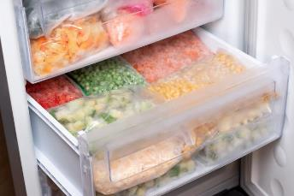
Frozen ingredients
Frozen fruit, vegetables and fish are often cheaper than fresh and they last much longer. It is often thought that frozen foods are not as fresh, but the vegetables and fruit are frozen as soon as they are picked so they can be fresher!
Frozen fruits and vegetables – vitamin C
Meat
Batch - cooked meals (e.g. excess Bolognese sauce)
*Not everything freezes well. Fruits and vegetables with high water content (e.g. lettuce) will break down if frozen and thawed.

Slide 14
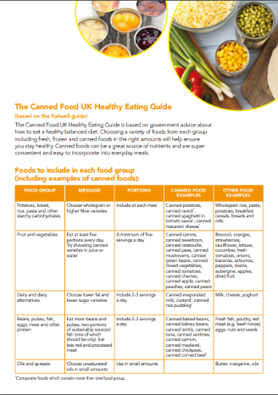
Canned ingredients
70% of food wasted in the UK is wasted by people in their own homes – the equivalent to 4.5 million tonnes of food each year.
Canned foods have a long shelf life – up to three years which helps to reduce food waste at home.
All canned food is cooked in the can, so it only needs to be heated up saving time and energy.
Choosing a variety of foods from each group of the Eatwell Guide including fresh, frozen, and canned foods (in the right amounts) contribute to a balanced diet.
All fruit and vegetables canned in their own juice counts towards your 5-A-DAY.
Canned food recipes.
https://www.cannedfood.co.uk/health-nutrition/

Slide 15

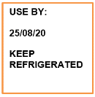



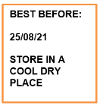

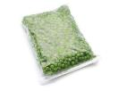
Reducing waste
In the UK, we throw away 6.6 million tonnes of household food waste a year. This is costs us on average up to £60 a month.
The foods most often wasted include:
bread and bakery products;
vegetables, salad, fruit;
drinks;
dairy products and eggs;
meat and fish products;
meals (homemade and pre-prepared).
Understanding food labels to help reduce waste: ‘use by’ and ‘best before’ dates.
Cheese, meat and milk
Canned, dried and frozen food
Notes:
This is one third of all food produced for human consumption, according to the Food and Agriculture Organization (FAO) of the United Nations. In the UK, we throw away 6.6 million tonnes of household food waste a year in the UK, almost three quarters is food we could have eaten
Use by’ dates do not always mean ‘eat by’. If a food can be frozen then its life can be extended beyond the ‘use by’ date. Follow the instructions on the packaging carefully such as ‘freeze on the day of purchase’ ‘defrost thoroughly before use and use within 24 hours’ or ‘cook from frozen’.

Slide 16
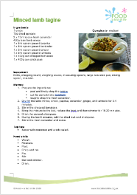
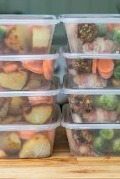

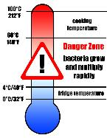

Reducing waste
Make homemade frozen meals
Double the recipe and freeze half
Check portion size
Don’t cook more than you need!
Keep a supply of frozen/canned fruit, vegetables and pulses
Long shelf life – use when needed
Get creative!
Find recipes to use up ingredients
Set the fridge at the correct temperature (between 0-5 ºC)
Avoid food going off unnecessarily.

Slide 17
Fuel efficiency
Using different types of cooking equipment can save time and money and help to reduce food waste. Top tips include:
Use the right size pan with a lid. Don't overfill the kettle!
Fill the oven - cook for future use.
Use the kettle for boiling water quickly and transfer to a pan on the hob for steaming or boiling vegetables or pasta.
Use an electric pressure cooker - these cook food quickly, so less energy is needed and cheaper cuts of meat can be used.
Slow cook foods – slow cookers cook food more slowly so you can use cheaper cuts of meat, save preparation time and washing up!
Notes:
With an eye on rising energy bills, shoppers appear to be searching for cheaper ways to cook as they try to avoid using their ovens.
Sales of cooking appliances including slow cookers, air fryers and sandwich makers, which generally use less energy, are up by 53%.
It typically costs 87p a day to run an electric cooker – amounting to £26.38 a month, or £316 a year – making it the most expensive of the cooking methods tested, according to the researchers.
Dual cookers typically have a daily cost of 72p, or £264 annually, and a gas cooker costs 33p a day to run. That adds up to £120 over 12 months.
Slow cookers cost 16p a day – £59 annually – to run, while air fryers typically add 14p a day to people’s energy bills, or £52 a year.
A microwave was found to be the cheapest option, costing only 8p a day to use, or £30 annually.

Slide 18
Did you know?!
Storing potatoes with an apple to keep them longer*. The ethylene gas given off by the apple helps to prevent potatoes sprouting and 'going bad'.
To diversify protein sources, add pulses to soups, stews and other dishes to increase protein content and make meat go further.
Pressure cookers are energy savers – reducing cooking time. Invest in an electric one!
Flatbreads can be cut into triangles and baked into pitta chips. Blitz crusts and stale bread into breadcrumbs and freeze.
When boiling water only use as much as you need, keep it covered.
Avoiding using the oven for one dish - using the space to cook other dishes saves time and fuel.
Meal planning is the best way to save money and cut down on waste.
Batch cooking saves time and energy - make big portions, freeze and use later in dishes.
Spinach, rocket or carrot tops that need using up can be used to make a tasty pesto.
*to reduce the risk of acrylamide forming, don’t store potatoes in the fridge

Slide 19
Did you know?!
Substituting oats for a third of the meat in a meatball recipe increases fibre and makes the meat go further.
Fresh herbs can be frozen if they are not going to be used. Chop and spread on a tray or place a measured amount in an ice cube tray and cover with water.
Many bottles of sauces are 80% water. Make own sauces / salad dressings / marinades.
Roast chickpeas with spices such as cumin seeds, paprika and chilli flakes make a nutritious snack or salad topper.
If you are batch freezing meals do not over-season with salt and chilli as these and some spices become stronger over time.
Empty freezers are more expensive to run, so the fuller it is kept, the less energy it is using.
A bottle of lemon or lime juice in the cupboard/fridge is cheaper than fresh fruit and will last longer.
Cooked pulses can be blended with roast vegetables such as sweet potato, beetroot, or carrots and olive oil/lemon juice to make a dip or filling for baked potatoes.
Fresh fish is about 35% more expensive than frozen.

Slide 20
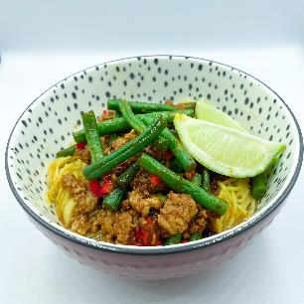
Easy, affordable, healthier recipe suggestions
Save money on meat – buy cheaper cuts and cook for longer or swap out some of the meat in a recipe for plant-based proteins such as beans or lentils.
Try pork mince – it is currently the cheapest mince available.
Buy chicken thighs instead of chicken breasts (remember to remove the skin).
Roast a whole chicken and use the meat for several meals – use the carcass to make soup!
Use canned or frozen fruit and vegetables – remember to choose fruit in juice and vegetables without salt.
Try couscous, bulgur wheat, freekeh, quinoa – these are good value and go a long way.
Asian style hoisin noodles recipe

Slide 21
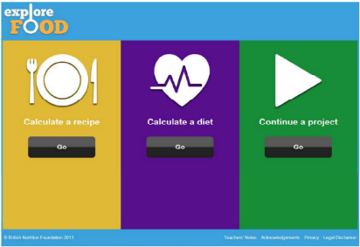
Explore food
Explore food is a simple online nutritional analysis tool available free to use from the British Nutrition Foundation’s Food – a fact of life education programme.
Explore food allows students to:
calculate the energy and nutrients provided by a recipe or diet;
model different portion sizes for a recipe;
compare the diet for a day to DRVs;
model different DRVs and the diet;
save work to continue another time (saved as a file); export work into a spreadsheet file for further analysis;
print work.
https://explorefood.foodafactoflife.org.uk

Slide 22
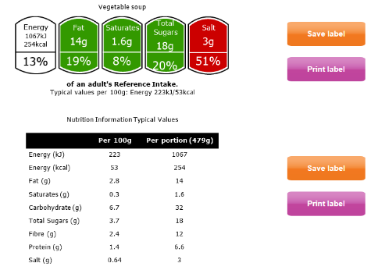
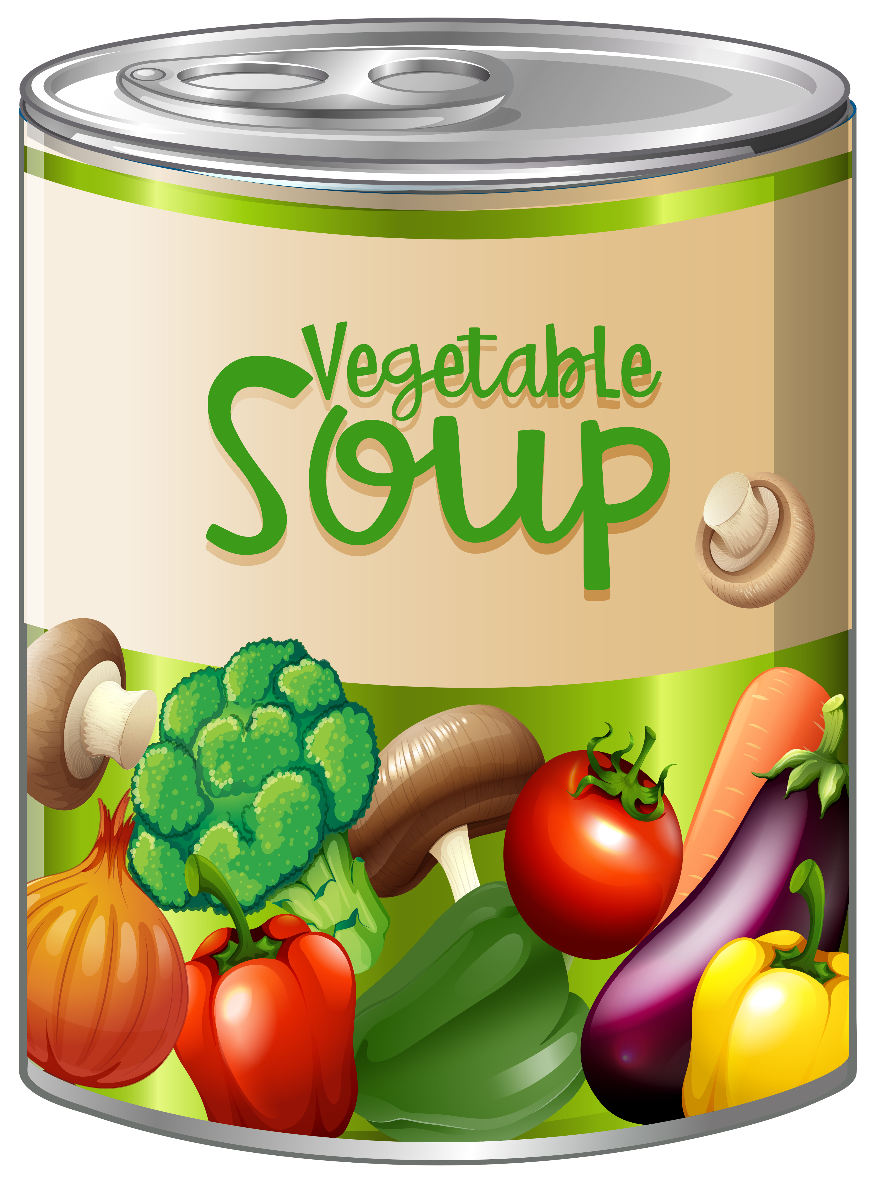
Example analysis
Ingredients and Nutritional value
Cost
Sensory analysis
Labels
Homecooked soup using seasonal vegetables
Bought canned soup comparison:
Worksheet looking at the sensory properties of canned soup.
Notes:
Homemade – canned basic – premium comparison
Nutritional analysis
Costing
Sensory analysis
Food labels

Slide 23
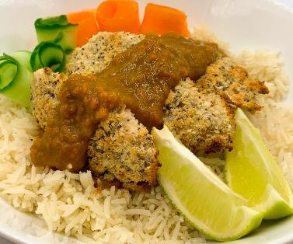
Fakeaways!
Make healthier and lower cost takeaway-style food at home or school, rather than buying it from a food outlet.
Try one of the recipes below – pupils enjoy creating their own ‘fakeaway’.
Pizza
Burgers
Fajitas
Curries
Pancakes
Recipes from around the world

Slide 24
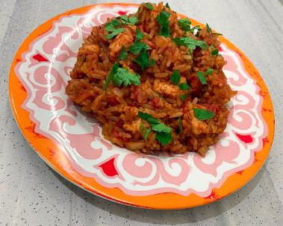
Easy, affordable recipe suggestions
Aldi
ASDA Good Living
BBC (recipes and advice)
British Nutrition Foundation
Canned Food UK
Cooking on a Bootstrap (Jack Monroe)
Jamie Oliver (Budget friendly recipes)
Lidl
Lovepork and Simply beef and lamb
Morrisons Healthy meals on a budget
Tesco Real Food
Jollof rice recipe

Slide 25
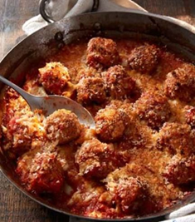
Pork meatballs with cheesy crumb topping
Why are we doing this?
A medium-high complexity recipe that would work well in a secondary classroom.
Uses pork mince which is a good value, lower fat source of protein. Meat alternatives can also be used.
A good opportunity to discuss identifying good value sources of protein and ways to reduce food waste.
Recipe uses a range of basic food skills and highlights good food hygiene practices (personal, food and equipment). The meatballs can be cooked in school, refrigerated when cool and finished off at home.
Covers science of food, numeracy and literacy in a variety of ways.

Slide 26
Pork meatballs with cheesy crumb topping
Ingredients
1 small onion
1 garlic clove or 1 x 5ml spoon garlic purée or paste
25g reduced fat hard cheese, e.g. Cheddar or similar
1 slice of bread or 25g breadcrumbs
250g pork mince (5% fat)
1 x 15ml spoon dried mixed herbs
Black pepper
1 x 5ml spoon oil or spray oil
1 x 400g can chopped tomatoes
1 x 15ml spoon tomato purée
50ml water
Method
Prepare the ingredients:
  peel and finely chop the onion;
  peel and crush or finely chop the garlic clove, if using;
  grate the cheese;
  blitz the bread into breadcrumbs, if need be;
  mix the cheese and breadcrumbs together in a small bowl.
Put the mince, half each of the onion, garlic and herbs in a bowl. Season with black pepper.
Mix the mince mixture well and shape into about 8 walnut-sized meatballs. Thoroughly wash and dry hands after touching the raw meat.
Heat the oil in a large non-stick heatproof frying pan and cook the meatballs for 8-10 minutes all over until brown. Transfer to a plate lined with kitchen paper.
Add the remaining onion, garlic and herbs to the empty frying pan.
Cook for 4-5 minutes until soft, but not coloured.
Add the chopped tomatoes, tomato purée and 50ml water. Season with black pepper.
Bring to the boil and reduce the heat to a simmer.
Return the meatballs to the pan and simmer for 10 minutes in the hot sauce.
Preheat the grill to a moderate heat.
Sprinkle the mixed cheese and breadcrumbs over the meatballs, place the pan under the preheated grill and heat for 3-4 minutes until the cheese melts and the breadcrumbs are golden and crispy. If the frying pan is not heatproof, transfer to a heatproof dish.
Notes:
For a diary-free mealie bread - substitute the butter and milk with plant-based versions.

Slide 27
Pork meatballs with cheesy crumb topping- review
Skills and knowledge developed and demonstrated | Practicalities in the secondary classroom | Alternatives – ingredients, cooking methods …
Practical food skills: Weigh, Measure
Peel, Chop, Crush, Grate, Blitz, Portion/ divide, Form and shape, Fry, Boil and simmer, Grill.
Nutrition science: Meat, vegetables, dairy and cereals in the diet.
Food science: The effect of cooking on meat.
Sensory science: testing, tasting and evaluation.
Numeracy: Weighing, measuring, dividing, time, temperature.
Literacy: reading and following a recipe, following written and verbal instructions.
Ingredients (purchase, storage, providing)
Equipment – blender/processor, pans
Storage pre-post cooking
Reheating instructions as needed
Meat free and gluten free options
Additional vegetables added to minimise waste.
Use different types of mince – compare cost/nutrition analysis
Use chopped tomatoes with added herbs and/or investigate the use of different herbs/flavouring.
Make pasta to serve with the meatballs.

Slide 28
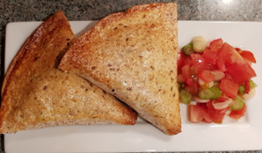
Mexican pockets
Why are we doing this?
A fun medium-high complexity recipe that works well in a secondary classroom.
Ideal for demonstrating how to reduce food waste.
Recipe uses a range of basic food skills and can be easily adapted for differentiation, and time, ingredients and equipment available.
Can be made individually, in pairs or groups.
Covers science of food, numeracy and literacy in a variety of ways.

Slide 29
Mexican pockets
Ingredients
1 spring onion
½ red, yellow or green pepper
25g cooked chicken or tofu (optional)
20g reduced fat Cheddar cheese
50g canned kidney beans, drained and rinsed
25g frozen peas
25g canned or frozen sweetcorn
½ x 5ml spoon chipotle paste or 1 x 5ml spoon mild chilli powder
1 egg or 1 x 15ml spoon milk
2 large tortilla wraps or 4 mini wraps
Method
Heat the oven to 200°C/gas mark 6. Line or lightly grease a baking tray.
Prepare the filling ingredients and place in a bowl:
  slice or snip the spring onions into rings;
  dice the pepper;
  chop the cooked chicken or tofu, if using;
  grate the cheddar cheese.
Add the kidney beans, peas and sweetcorn to the bowl. Stir in the chipotle paste or chilli powder.
Crack the egg into a jug and mix well with a fork.
Cut the wraps in half and brush the edges of each half with the beaten egg.
Leave for 30 seconds and then fold into a cone shape sealing the edges carefully.
Fill each cone 2/3rds full with mixture. Do not overfill otherwise they will be difficult to seal.
Brush the inside edges with egg. Leave for 30 seconds and then seal by pressing the edges together firmly.
Place the pockets on the baking tray and brush with egg.
Bake in the oven for 10 minutes until golden.

Slide 30
Quick salsa
Ingredients
1 tomato
1 spring onion
1 x 5ml spoon lime juice (freshly squeezed or from a bottle)
¼ fresh chilli or 1 x ¼ 5ml spoon chilli flakes
Method
While the pockets are baking, prepare the salsa ingredients:
dice the tomato;
slice or snip the spring onion;
finely dice the fresh chilli;
squeeze the lime, if using a fresh lime;
2. Place all the ingredients in a small mixing bowl, add 1 x 5ml spoon of lime juice and mix well.

Slide 31
Mexican pockets
Skills and knowledge developed and demonstrated | Practicalities in the secondary classroom | Recipe development / Progression over time
Practical food skills: Weigh, Chop, slice and dice, Grate, Mix, stir and combine, Shape, Glaze, Bake
Nutrition science: Starchy carbohydrates, fruit and vegetables in the diet.
Food science: Glazing, heat transfer.
Sensory science: testing, tasting and evaluation.
Numeracy: Measurement, size, shape.
Literacy: Reading and understanding a recipe, following written and verbal instructions.
Ingredients (purchase, providing, storage
Equipment – suitable size and number of frying pans
Use of the hob and heat control to prevent over cooking
Gluten free option
H&S for fresh chilli preparation
Make tortilla wraps for the recipe – extras can be frozen for later use
Develop the recipe using cooked minced beef that is 'left over' from another dish.
Prepare houmous to serve with the pockets.
Develop ideas for the salsa.

Slide 32

Comfort break – 10 minutes
Grab a cuppa and try your
Mexican pockets!

Slide 33
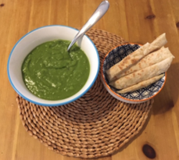
Super soup and Speedy flatbreads
Why are we doing this?
Two quick, simple recipes that work well in a secondary classroom.
Ideal for encouraging creativity and independence, along with adapting a recipe/ingredients to what is available at the time.
Recipe uses a range of basic food skills and can be easily adapted for differentiation.
Can be made individually, in pairs or groups.
Covers science of food, numeracy and literacy in a variety of ways.

Slide 34
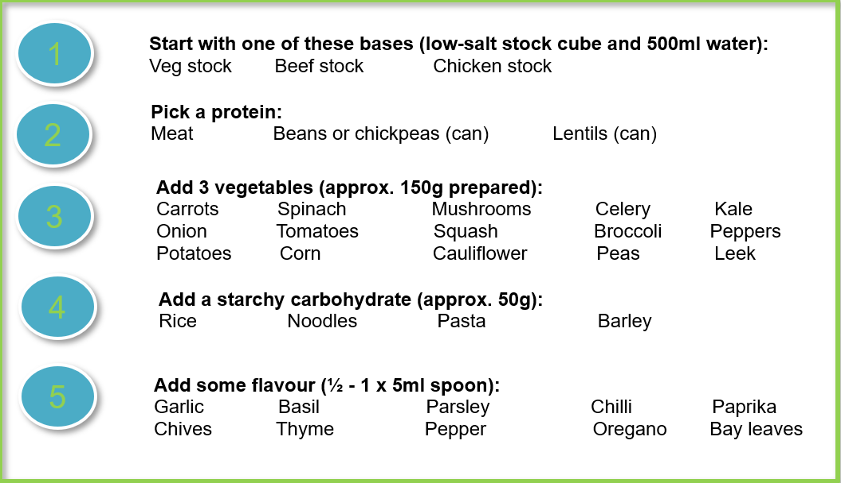
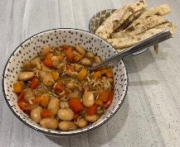
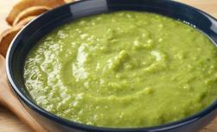
Build your own soup

Slide 35
Super soup
Ingredients – soup
500ml stock: e.g. vegetable, beef or chicken
Protein source: e.g. meat, beans or pulses
3 different vegetables
Starchy carbohydrate: e.g. rice, noodles, pasta, barley
Flavour: e.g. garlic, dried or fresh herbs, spices
Method - soup
Peel, chop, dice or slice the vegetables. Crush the garlic if using.
Heat 1 x 5ml spoon, or a few sprays, of oil in a saucepan and gently fry the onion and garlic, if using.
If using raw meat, brown this with the onion.
Add the other vegetables to the pan. If using spinach or mushrooms, add these five minutes before the end.
Add your chosen protein* and starchy carbohydrate. Remember to drain and rinse any canned beans or lentils.
Add 500ml stock to the pan and bring to the boil. Add your seasoning/flavour.
Reduce the heat and simmer for 20 minutes or until the vegetables and starchy carbohydrate are cooked.
*depending on what you choose the protein may be added later in the cooking time

Slide 36
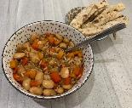
Speedy flatbreads
Ingredients – flatbreads
150g self-raising flour
150g low fat natural yogurt
Black pepper
Extra flour for kneading
Flavouring (optional): cumin seeds, chopped garlic, coriander or chillies
Method – flatbreads
Mix the flour, yogurt and black pepper in a bowl.
Tip onto a clean, floured surface and knead gently until smooth.
Divide the dough into four and shape into balls.
Flatten and shape into a circle, about the size of a saucer or 12-14 cm.
If using added flavourings: scatter the shaped dough with cumin seeds, chopped garlic, coriander or chillies. Fold the dough in half, roll-out or shape again into a circle.
Heat the non-stick frying pan and cook the flatbreads one by one until they are crisp and golden, approximately 2-3 minutes each side.

Slide 37
Super soup and Speedy flatbreads - review
Skills and knowledge developed and demonstrated | Practicalities in the secondary classroom | Recipe development / Progression over time
Practical food skills: Measure,
Weigh, Peel, Trim, Dice, slice and chop, Fry, Boil and simmer, Mix, Shape.
Nutrition science: protein, fruit and vegetables and starchy carbohydrates in the diet.
Food science: Heat transfer /exchange, the effect of cooking (coagulation, dextrinization, Maillard reaction).
Sensory science: testing, tasting and evaluation.
Numeracy: Weighing, measuring, shaping, temperature, time.
Literacy: Reading and understanding a recipe, following written and verbal instructions.
Availability of equipment
Health and safety – hot pans, movement
Temperature control
Storage and transportation home
Investigate and make different types of flatbreads – consider their origin, method of cooking, ingredients used.
Compare the nutritional and sensory properties of different types of soup.
Use seasonal vegetables/ingredients to prepare soup. Complete a cost comparison with bought.
Investigate soups from other countries. Make a selection and taste.

Slide 38
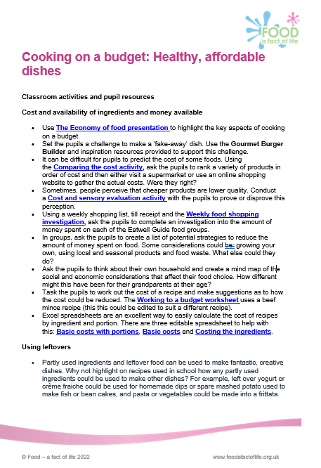
Support from Food – a fact of life and
British Nutrition Foundation
Cooking on a budget classroom activities and resources
Explore food nutritional analysis programme and supporting resources
Webinar presentations and recordings
Tackling food waste in schools presentation and recording
Practical food skills, cooking and reducing food waste presentation and recording
British Nutrition Foundation: Tips to save money on food

Slide 39
Support on Food – a fact of life and BNF
Food and nutrition key terms and definitions – New!
A presentation looking at budgeting
An activity to calculate the cost of a recipe
A presentation around the advantages and disadvantages of different types of shopping
Healthy sustainable diets – range of resources and activities
Healthy and sustainable diets - what needs to be considered? (Presentation)
The economy of food: a presentation exploring the key aspects of food choice and cooking on a budget.
Some tips to save money on food (British Nutrition Foundation)
Weekly meal planner template
About 'pulses' and how can they be used in the diet.
Try, Swap, Change' planner is a 'personalisable' resource to help enable change

Slide 40
Support on Food – a fact of life and BNF
Food waste presentation and worksheet.
Using leftovers presentation and cards.
A teacher's guide looking at leftovers and food waste.
Seasonality presentation.
Resource management presentation and worksheet.
Economy gastronomy poster.
Seasonality presentation (11-14) and 14-16 presentation.
External resources:
British Dietetic Association: Eat well, spend less: food factsheet
Seasonal food - downloadable factsheet
BBC Good Food – Budget recipes and meal plans

Slide 41

What’s next?
What can you do to extend and consolidate the skills and knowledge learned?
How can you use the information from the session to plan practical activities and support pupils, parents/carers and families?
How are you going to use today’s workshop to save you, your pupils and their families money when planning what to eat, shopping and cooking?
Who can you work with in school to make this happen?
Complete your planner now – it helps to make it happen!

Slide 42

Stars and a wish
What are you and the wider school community currently doing (or plan to) around the cost of living crisis to support pupils, parents/carers and families (and your school budget)?
Create a wish.........plan your next steps:
At school we support our pupils and families through: | At school I/we plan to:

Slide 43
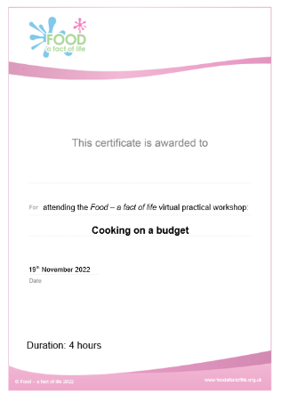
Last words ...
Evaluation – a link will be sent to you. When completed …
Personalised certificate – will be emailed to you

Slide 44
Thank you for joining!
For further information, go to:
www.foodafactoflife.org.uk

