Slide 1

Training and resources decision tree (KS1-3)
Oak – Food curriculum to classroom
click here to get started

Slide 2
Welcome
This decision tree has been designed to help you find the Oak training and resources easily.
Follow the slides, using the navigation buttons in the bottom-left to move around.
Overviews are provided for the training and resources, with links.
Additional links are made to curated resources and support on Food – a fact of life.
Key
home
back
next
end
end
end

Slide 3
Which age phase do you teach?
Click an option:
primary
secondary

Slide 4
Primary: What area do you want to explore?
Click an option:
training
resources

Slide 5
Primary - training
Click an option:
explore Oak
plan your CPD
create your SoL
primary focus
additional needs

Slide 6
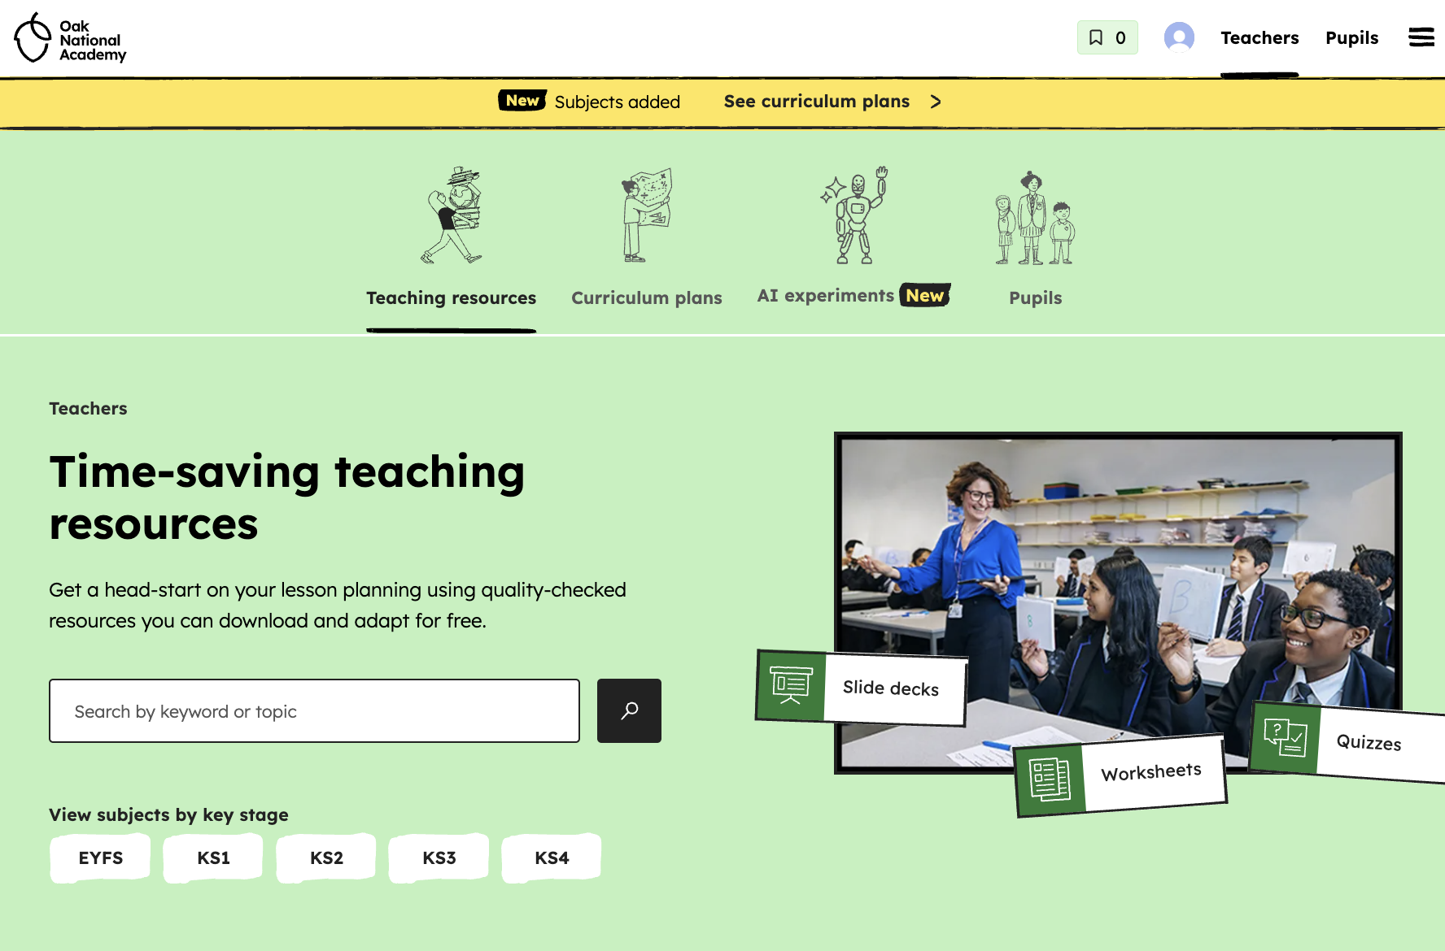
Primary – explore Oak
Getting started with Oak: What the new food curriculum offers you
• Welcome and purpose of the Oak food curriculum
• Curriculum overview and structure
• Explore key principles: knowledge and vocabulary rich, sequenced and coherent, flexible, accessible, diverse and evidence-informed
• Overview of lessons and materials available
• Practical guidance and demonstration - how to access everything for free
• Implementation in your school
• Next steps for you
Access now

Slide 7
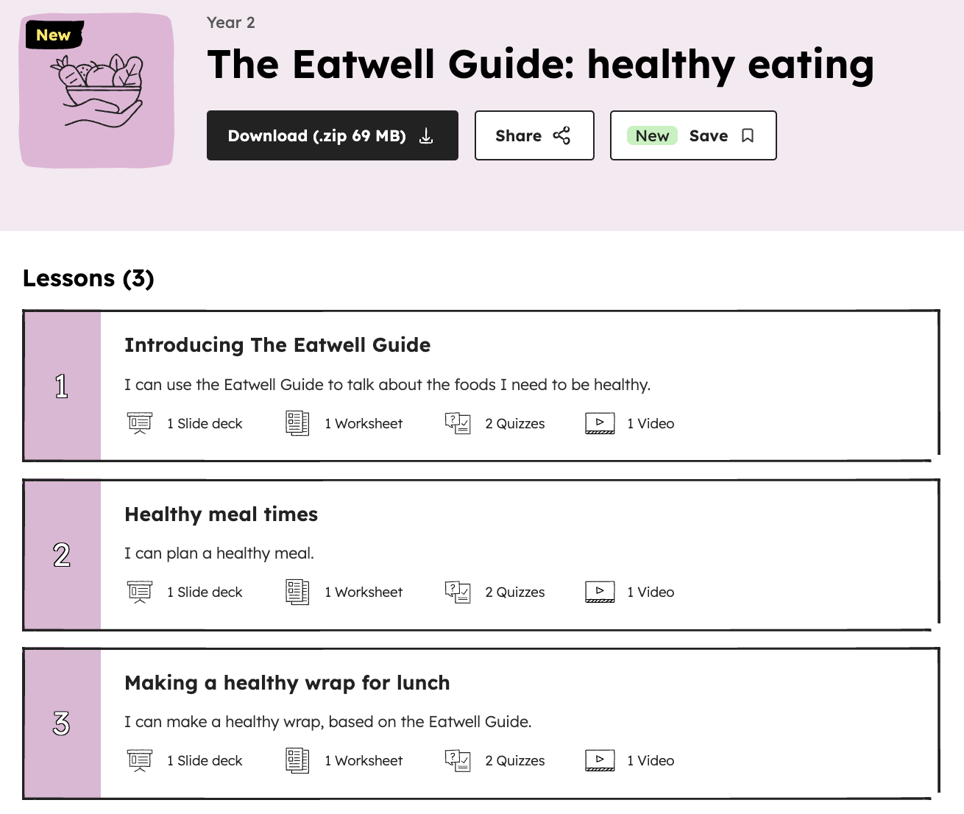
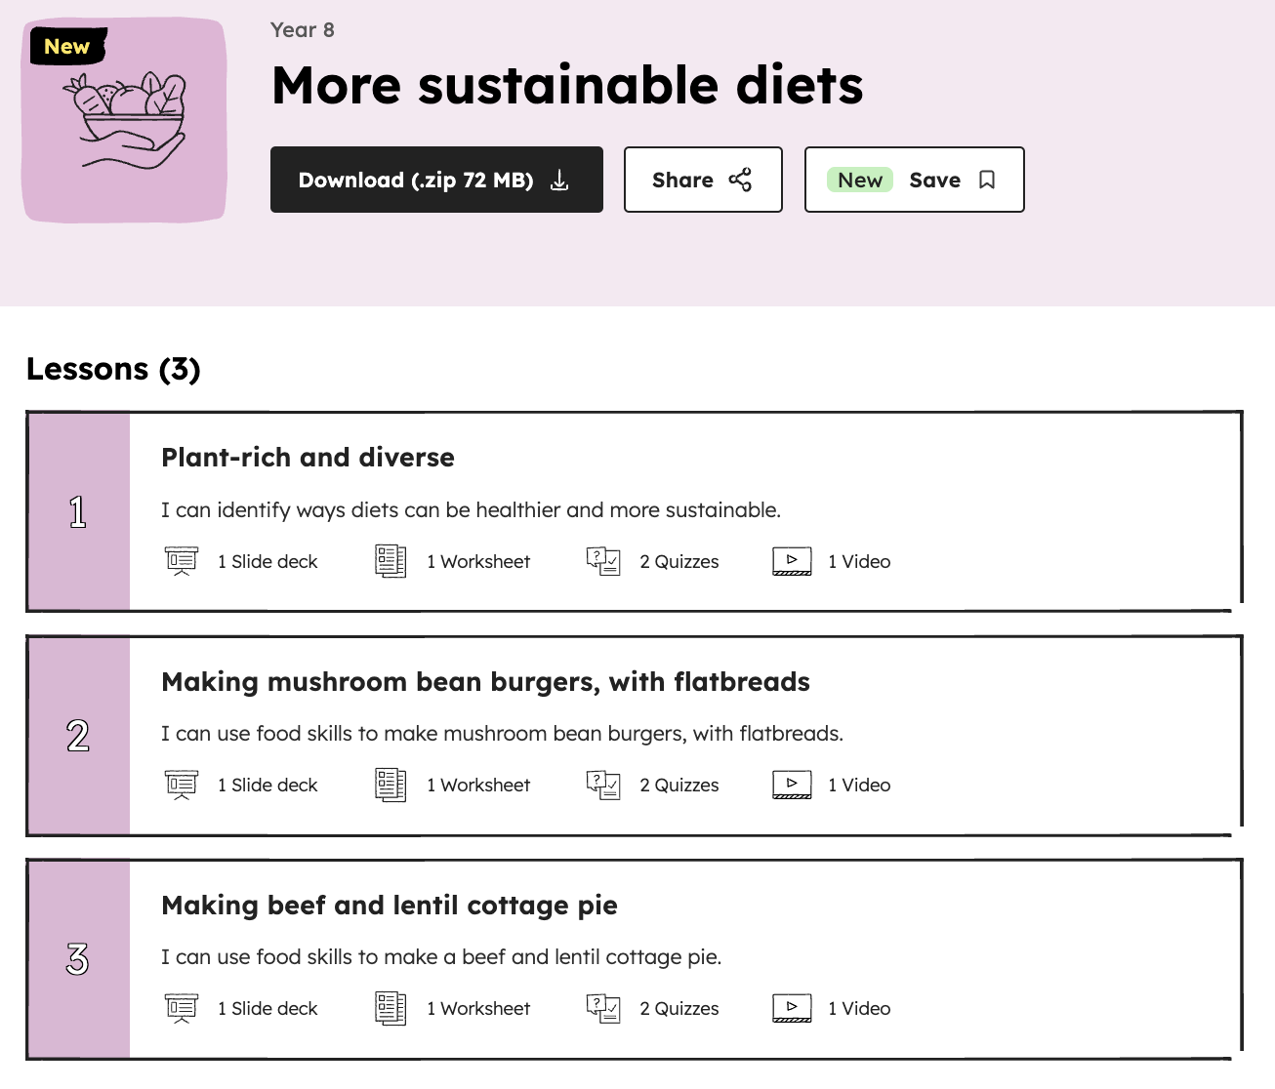
Primary – explore Oak
Inside the curriculum: Unpacking Oak’s approach to food
Curriculum aims and purpose, including aspects of practical work, health and sustainable eating, and cultural appreciation
Curriculum structure, threads, units and lessons, within a social context
Exploring the 108 lessons: slides, videos, worksheets, quizzes, recipes, and teacher support materials
Practical food work and embedding knowledge
Support and resources available for FREE for you
Next steps for you
Access now

Slide 8
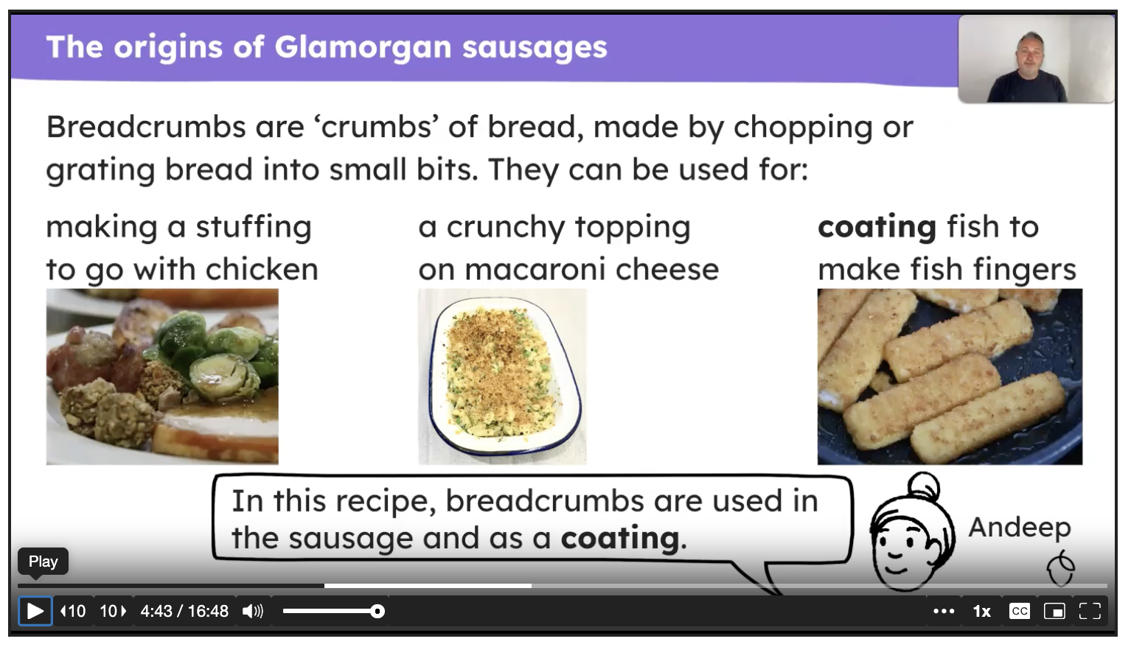
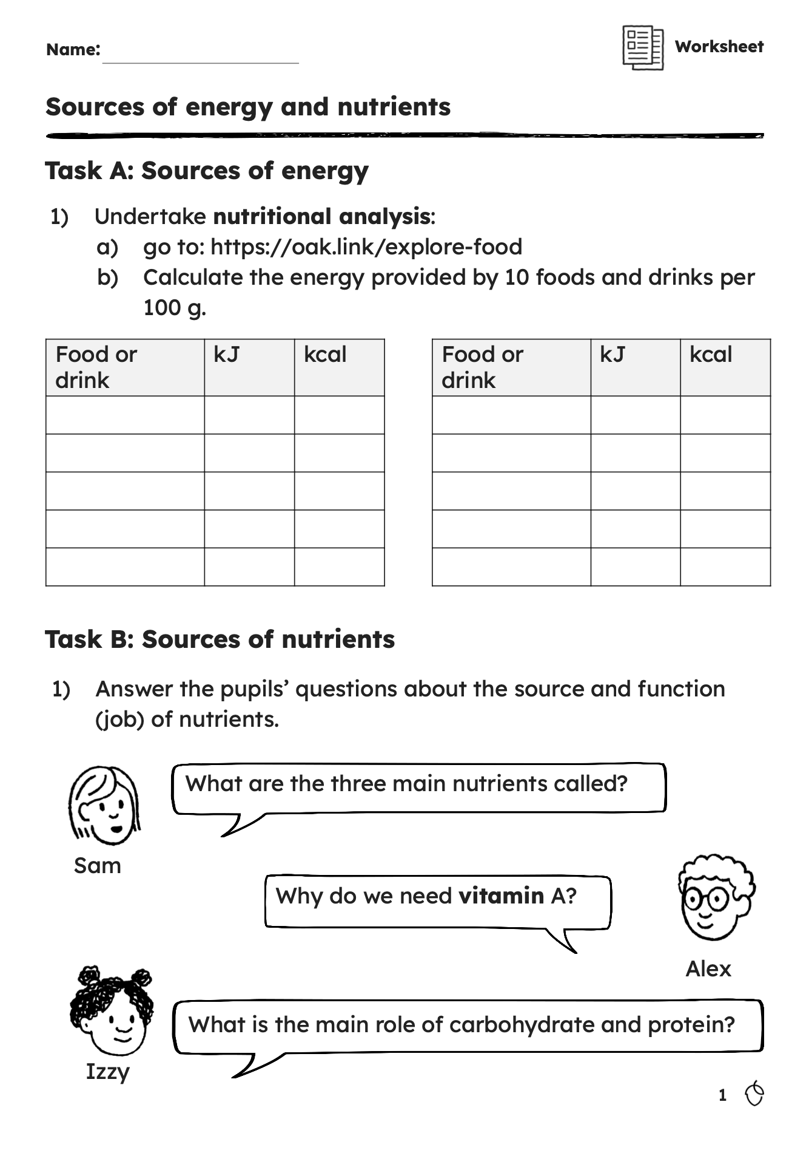
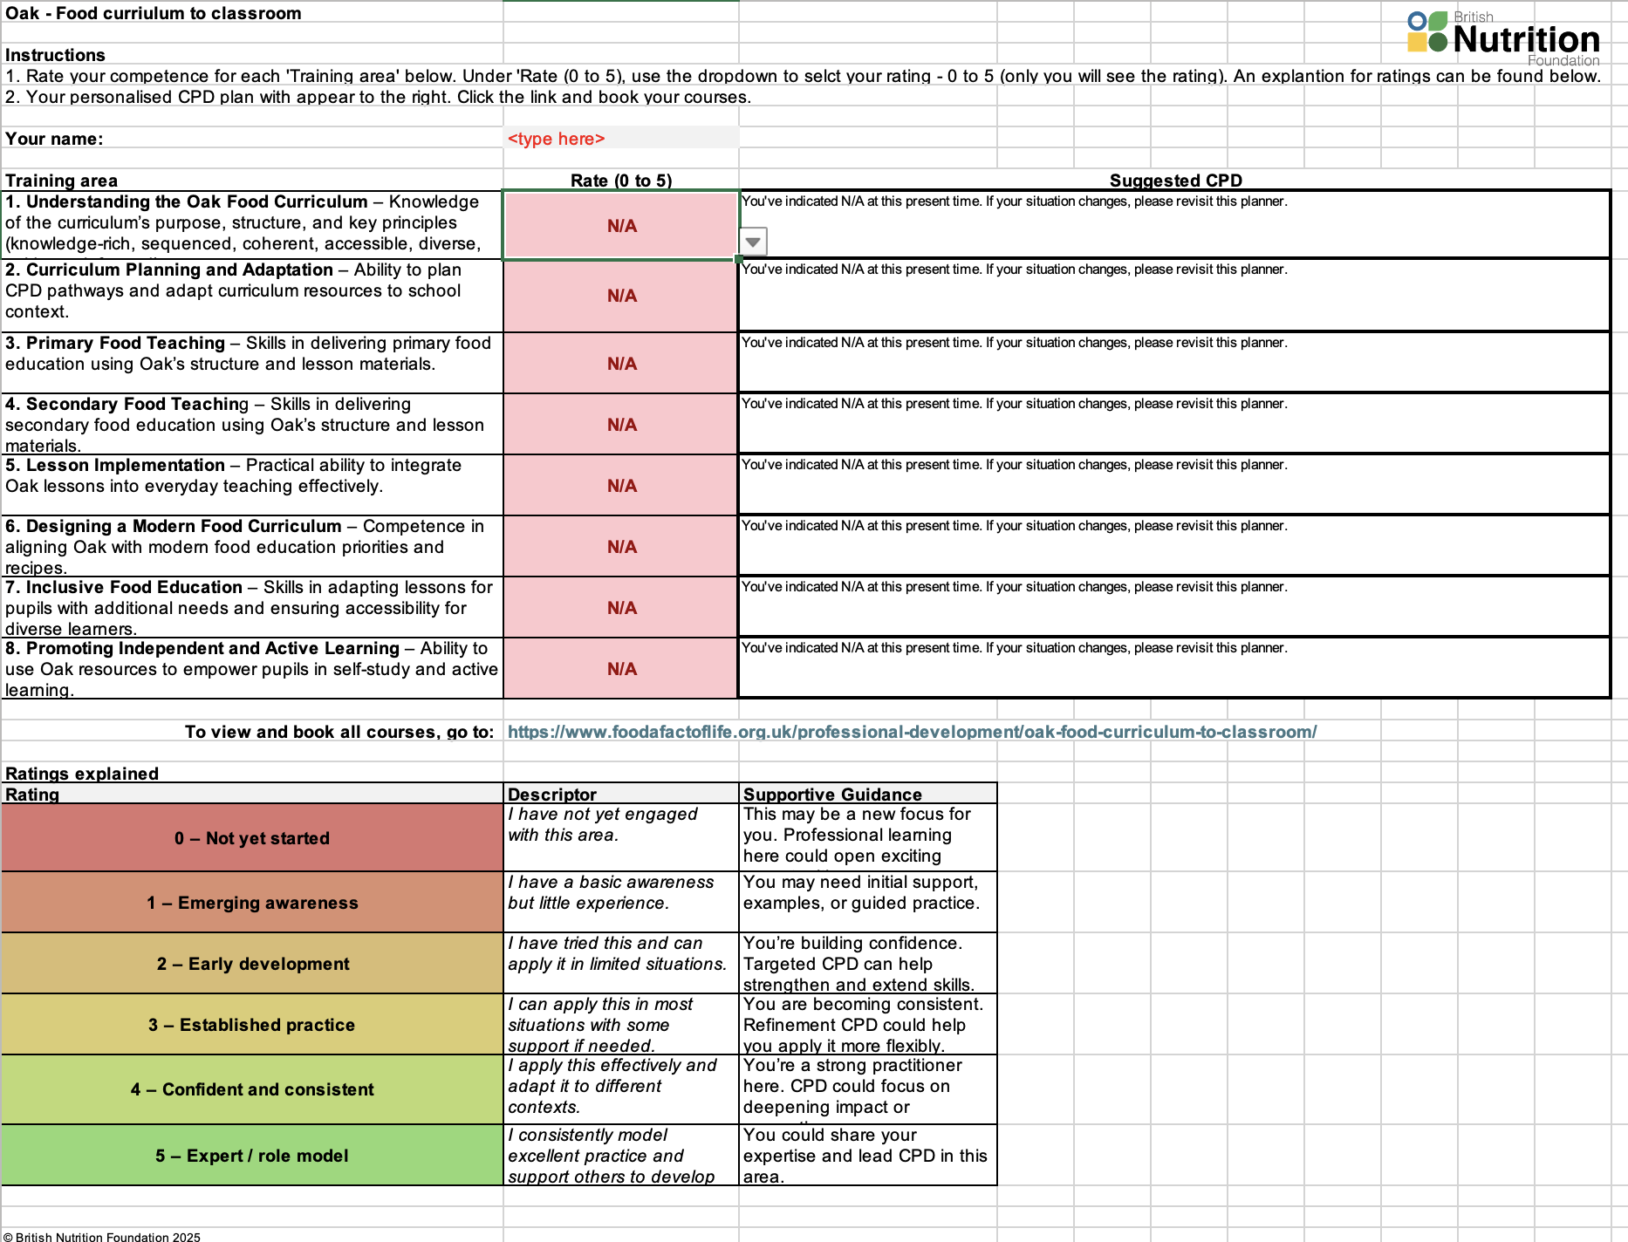
Primary – plan your CPD
Map your own path: Planning CPD that works for you and your team
Exploring Oak's curriculum and teaching resources
Using Oak materials for CPD development
  lesson videos: watch to observe pedagogy, vocabulary use, modelling
  lesson slides, quizzes and worksheets: reflect on what subject knowledge teachers need to support these
  recipes: opportunities for departmental practice, rehearsal, resource planning
Planning your own CPD using interactive tools
  competence rating and personalised plans
  SMART goal setting
Next steps for you
Access now

Slide 9
Primary – plan your CPD
10 CPD Courses
There are 10 different Oak courses available to support your professional development. Review each to see which is most appropriate for your needs.
Getting started with Oak: What the new food curriculum offers you
Map your own path: Planning CPD that works for you and your team
Inside the curriculum: Unpacking Oak’s approach to food
Primary food teaching made easy with Oak
Bringing Oak to life in secondary food lessons
Making Oak work in primary: Practical tips for the classroom
Making Oak work in secondary: Strategies for success
Designing a modern food curriculum with Oak as your foundation
Inclusive food education: Adapting Oak for learners with additional needs
Empowering pupils: Using Oak for independent and home learning
Access now

Slide 10
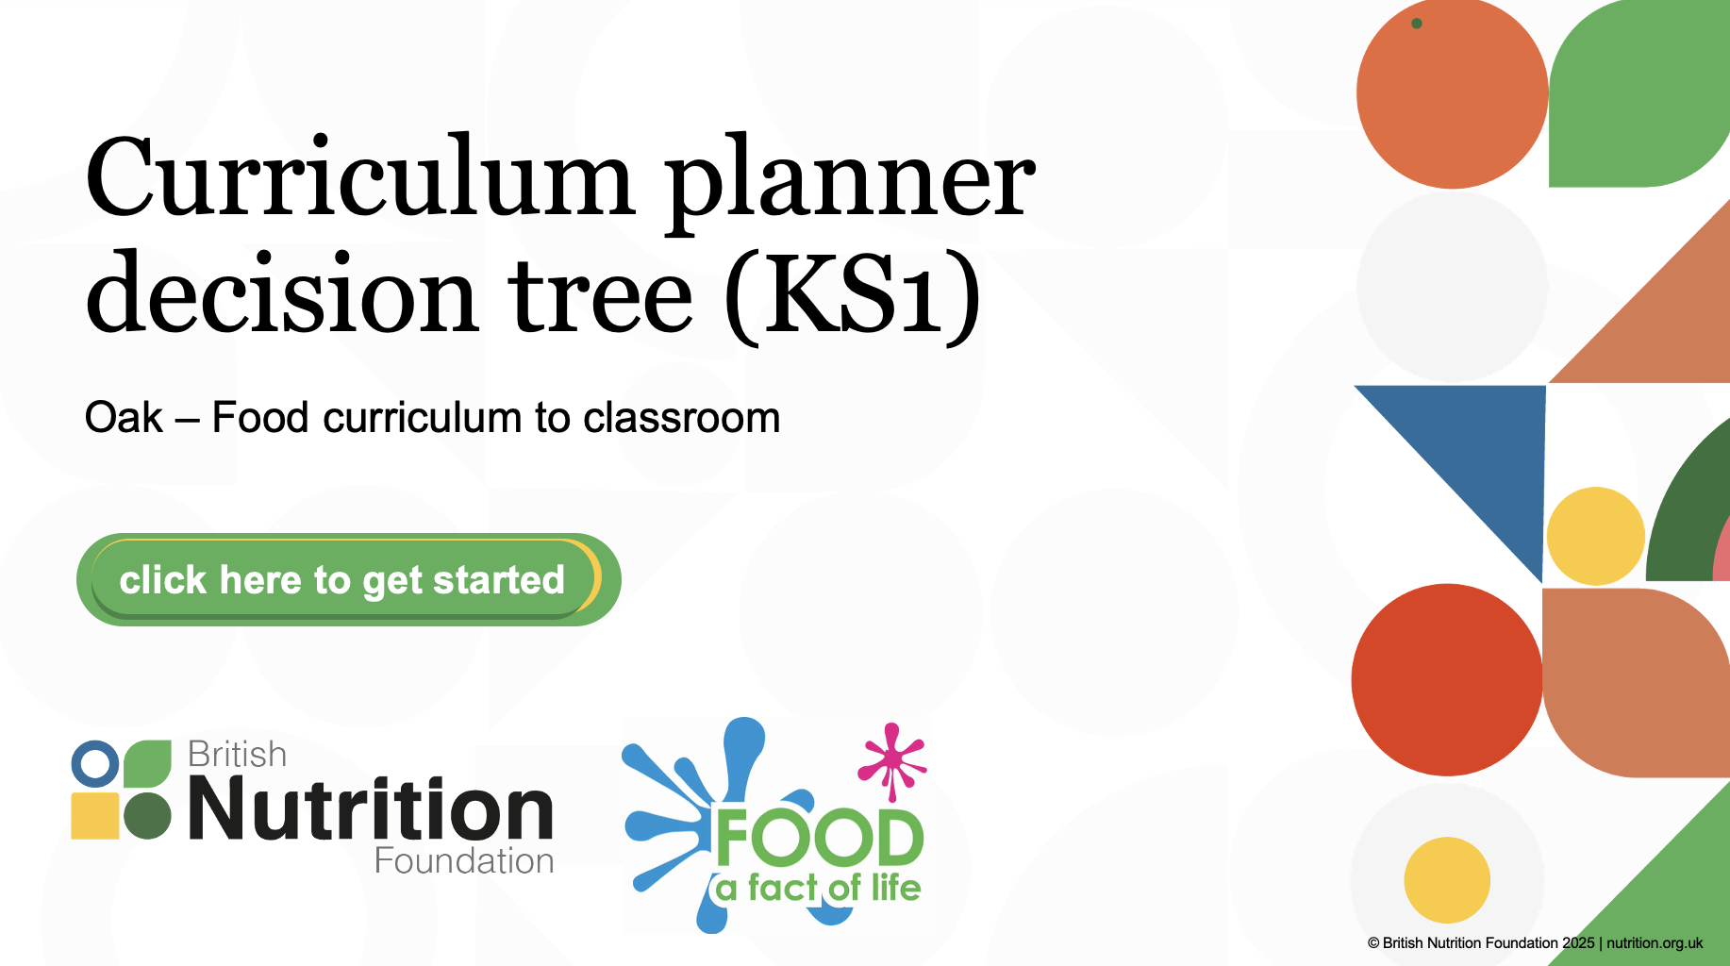
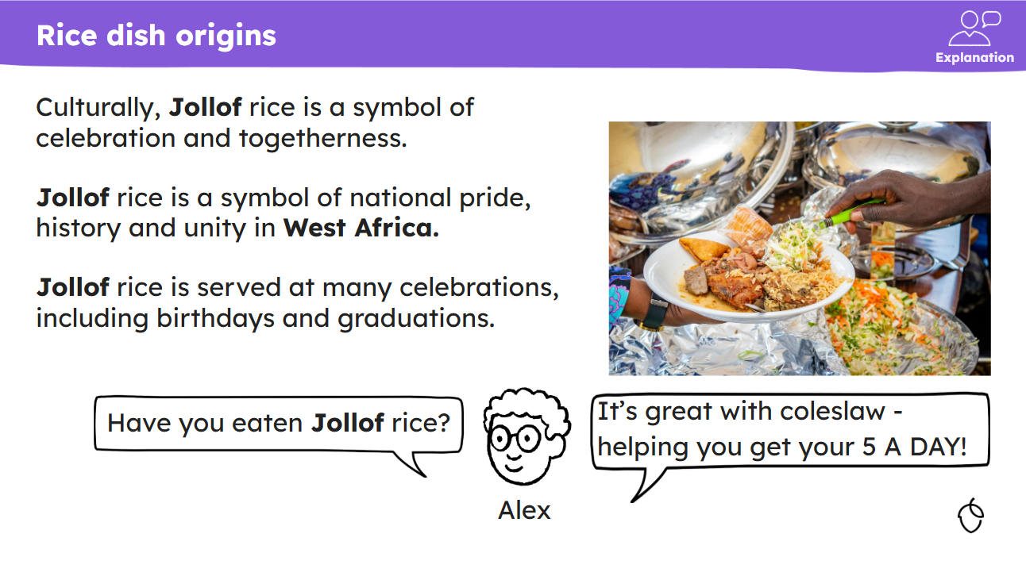
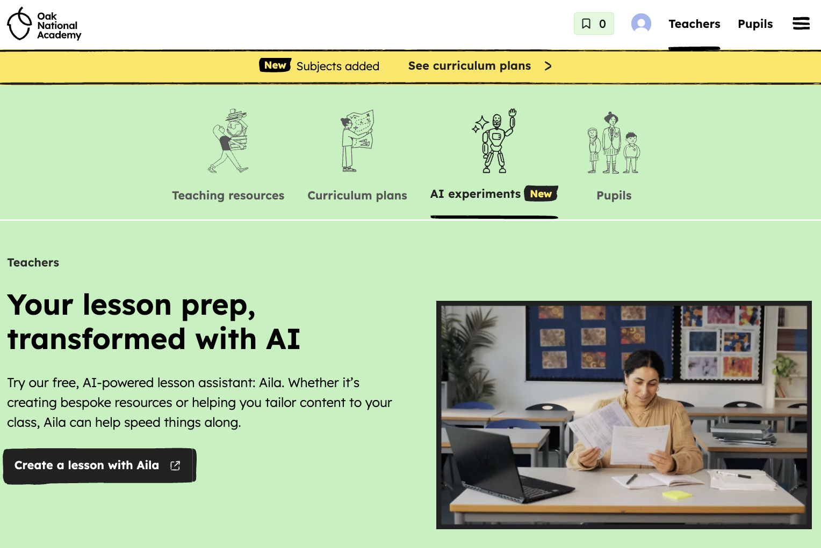
Primary – create your SoL
Designing a modern food curriculum with Oak as your foundation
Exploring a modern food curriculum
Recipe diversity and Oak
The social context and dimension of food
Planning and mapping progression across the Key Stages
Using tools, planners and AI to build great lessons with rigour
Reviewing your CPD opportunities
Next steps
Access now

Slide 11
Primary – create your SoL
Inside the curriculum: Unpacking Oak’s approach to food
Curriculum aims and purpose, including aspects of practical work, health and sustainable eating, and cultural appreciation
Curriculum structure, threads, units and lessons, within a social context
Exploring the 108 lessons: slides, videos, worksheets, quizzes, recipes, and teacher support materials
Practical food work and embedding knowledge
Support and resources available for FREE for you
Next steps for you
Access now

Slide 12
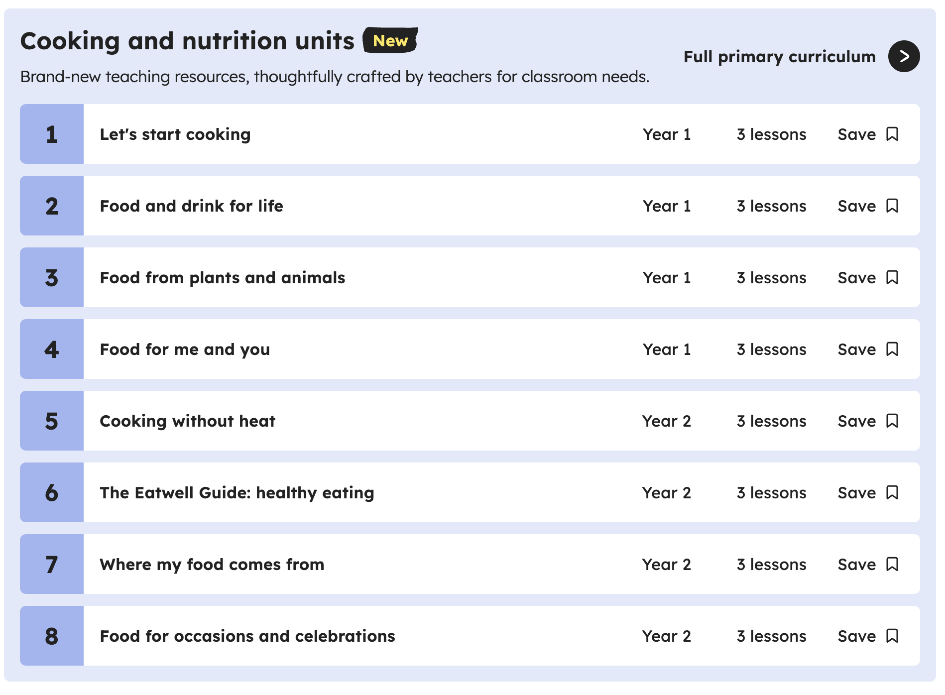
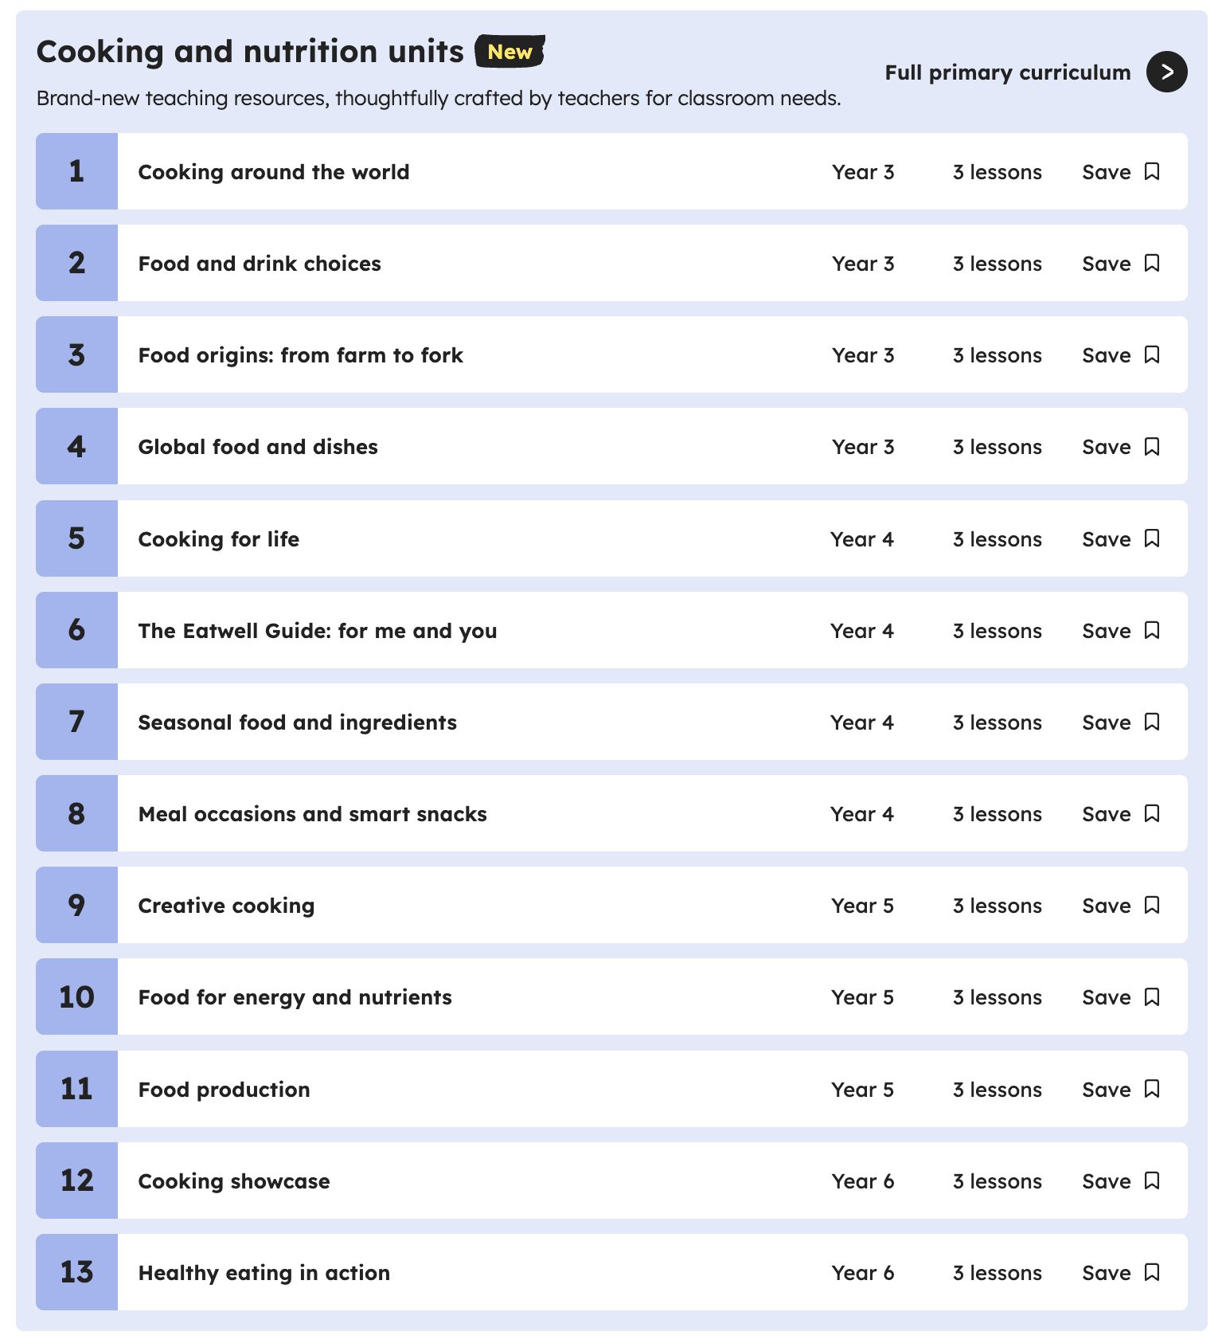
Primary – primary focus
Primary food teaching made easy with Oak
The Oak food curriculum structure, threads, units and lessons
Exploring KS 1 and KS2 lessons: slides, videos, worksheets, quizzes, recipes, and teacher support materials
Discover the free editable resources for use in the classroom - Year 1 to Year 6 (72 lessons in total)
Practical guidance and demonstration of the website and resources available
Explore support for your pupils
Review CPD opportunities for you
Support and resources available for FREE for you
Next steps for you
Access now

Slide 13
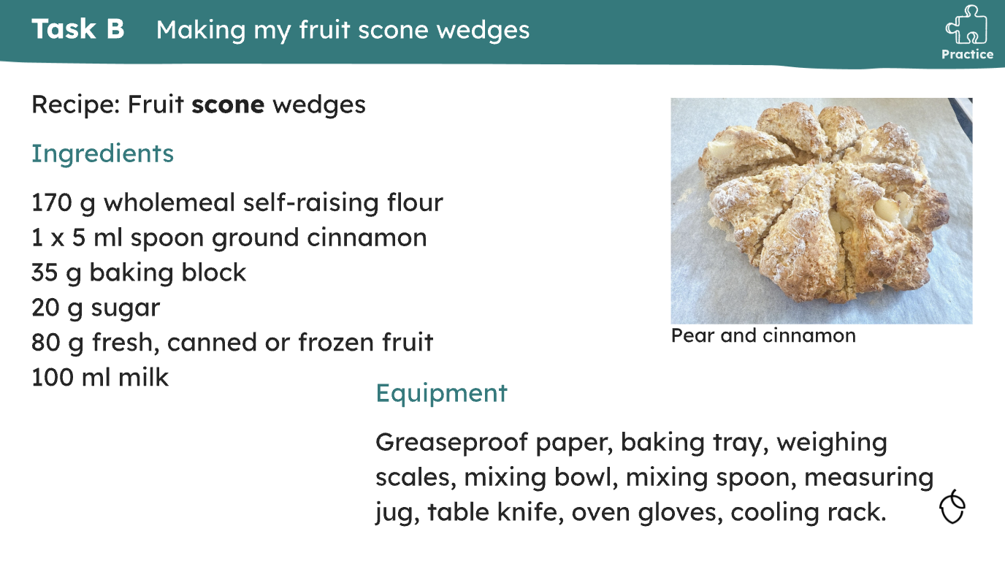
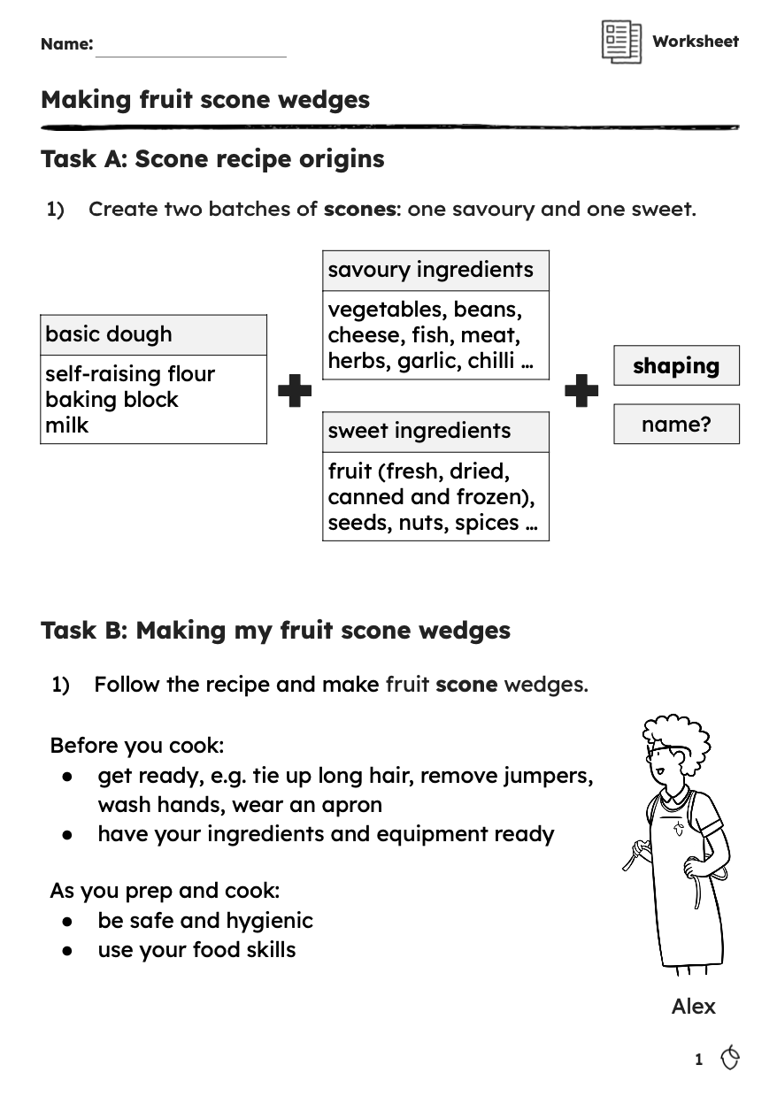
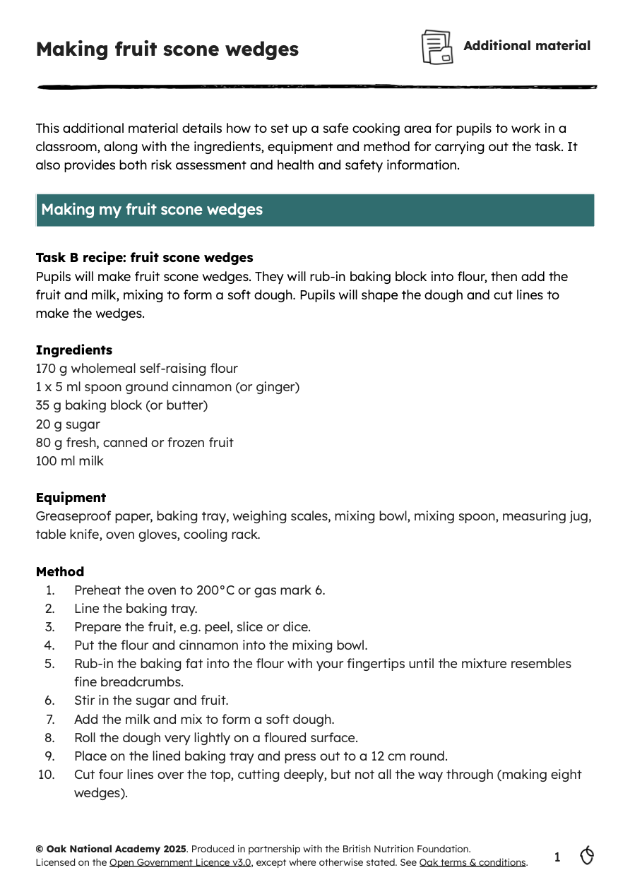
Primary – primary focus
Making Oak work in primary: Practical tips for the classroom
An overview of the Oak food curriculum for KS1 and KS2
How Oak supports good food teaching
What is available for you and your school
Pragmatic approaches to:
a) deciding what, why and how to teach
b) planning and managing cooking and tasting sessions
c) dealing with allergies
d) covering curriculum content
e) time and resource constraints and opportunities
Discover instant support for your pupils
Review your CPD opportunities
Next steps
Access now

Slide 14
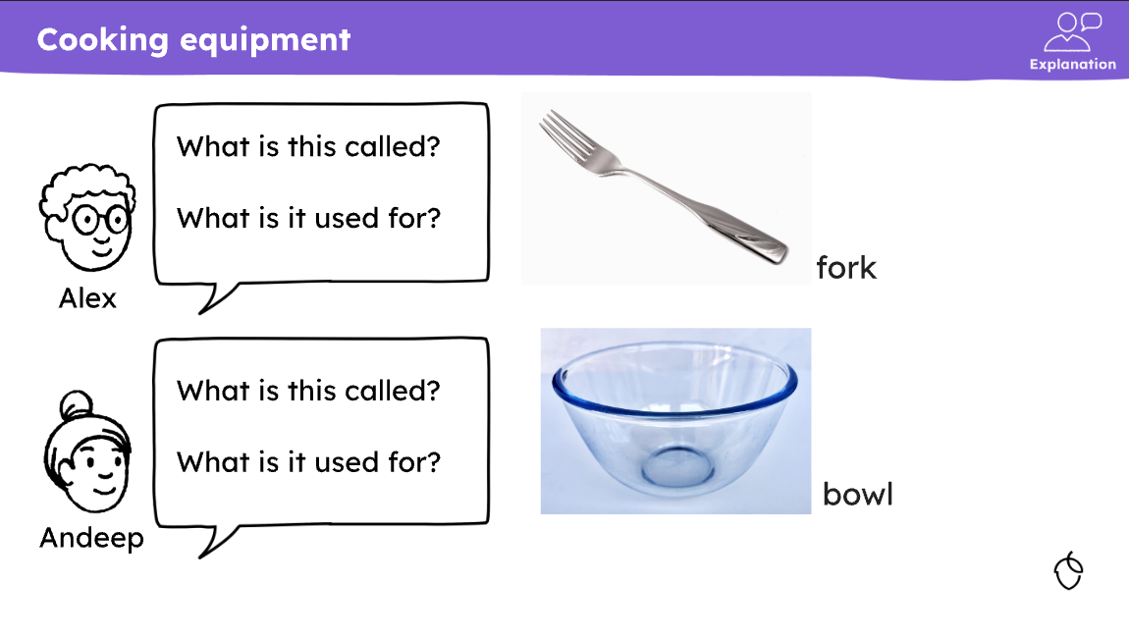
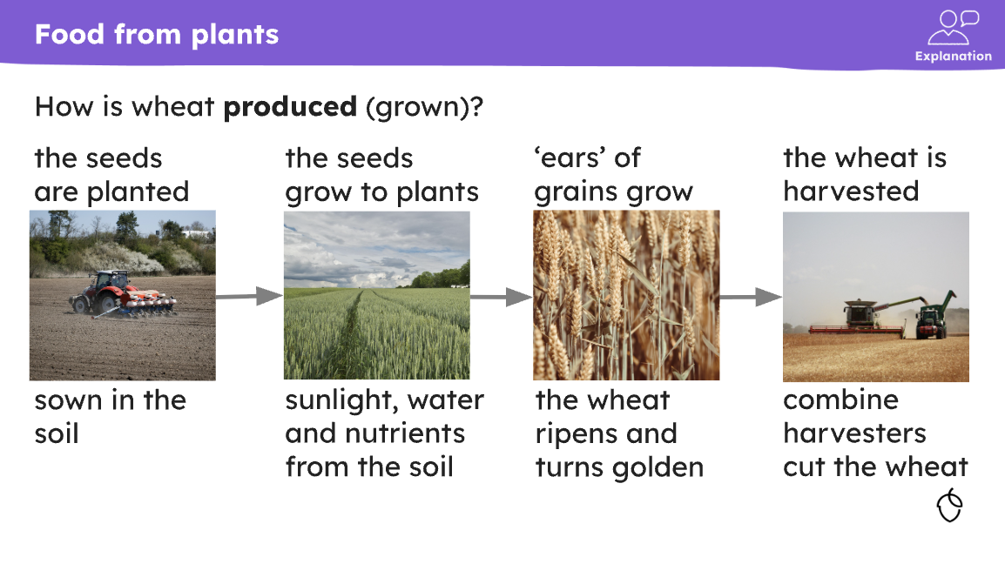
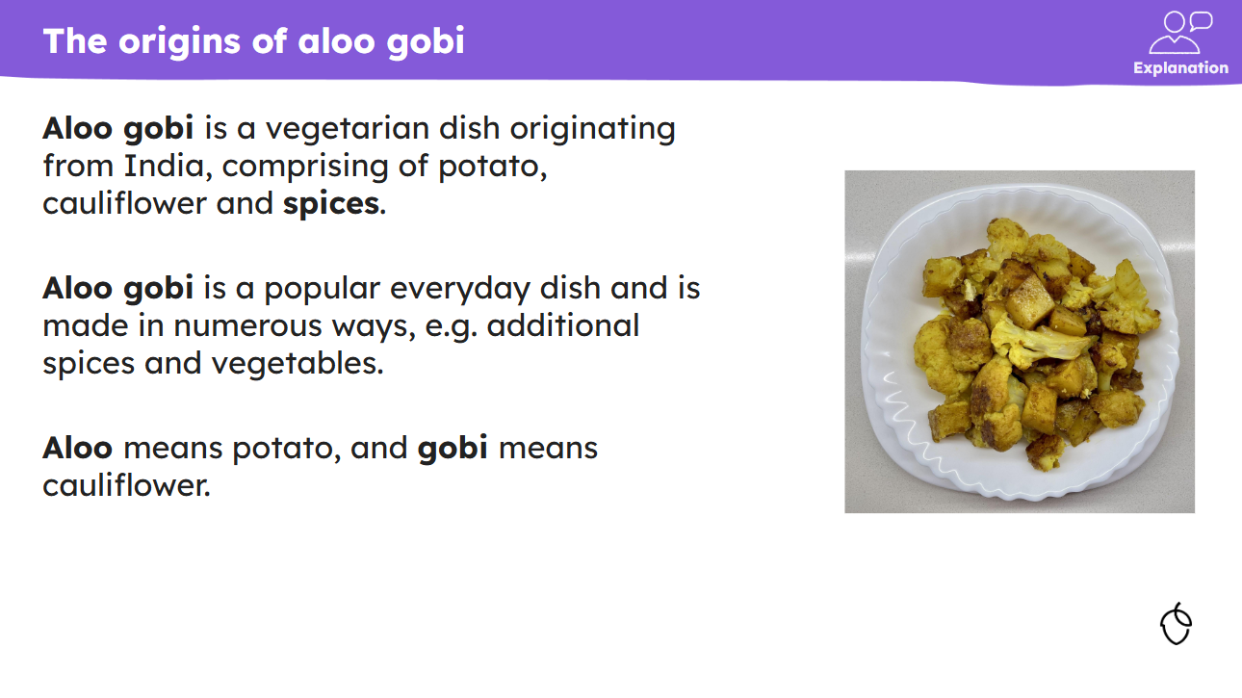
Primary – additional needs
Inclusive food education: Adapting Oak for learners with additional needs
• Adapting the Oak food curriculum for pupils with additional needs
• Curriculum strengths for learners, such as structure, progression, flexibility and clear vocabulary
• Practical ways of using and adapting Oak food lessons and materials
• Reviewing your CPD opportunities
• Next steps
Access now

Slide 15
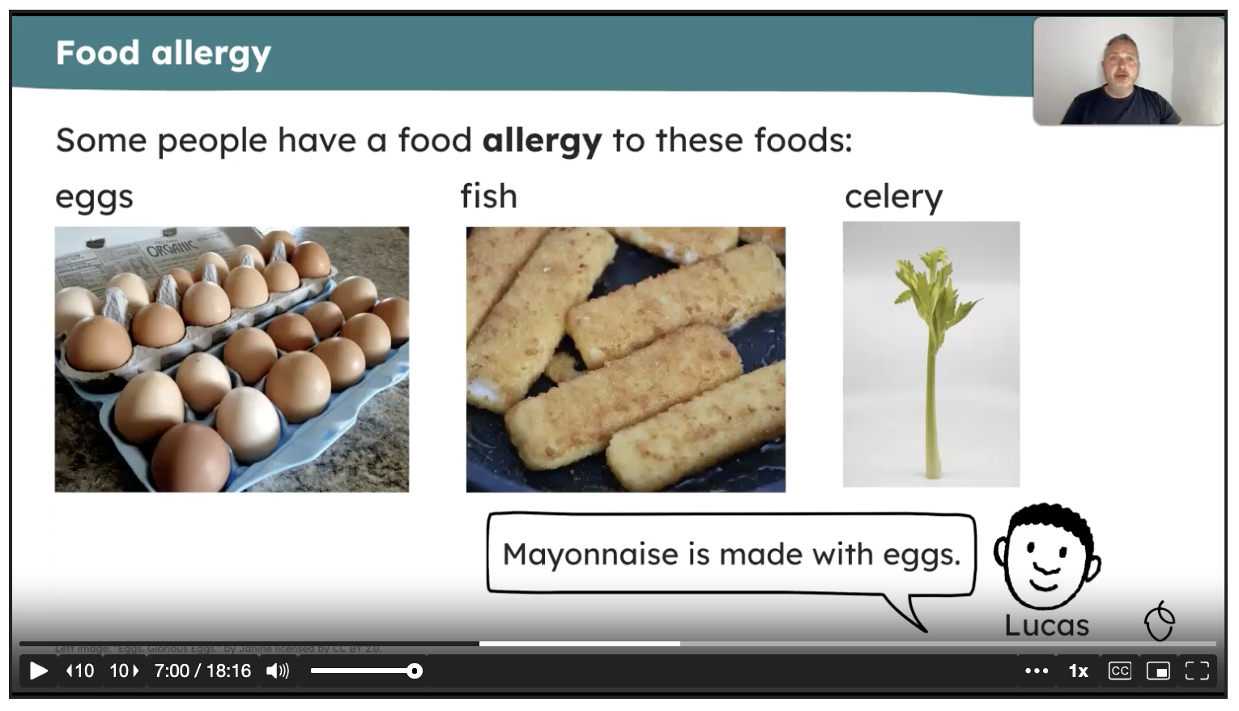
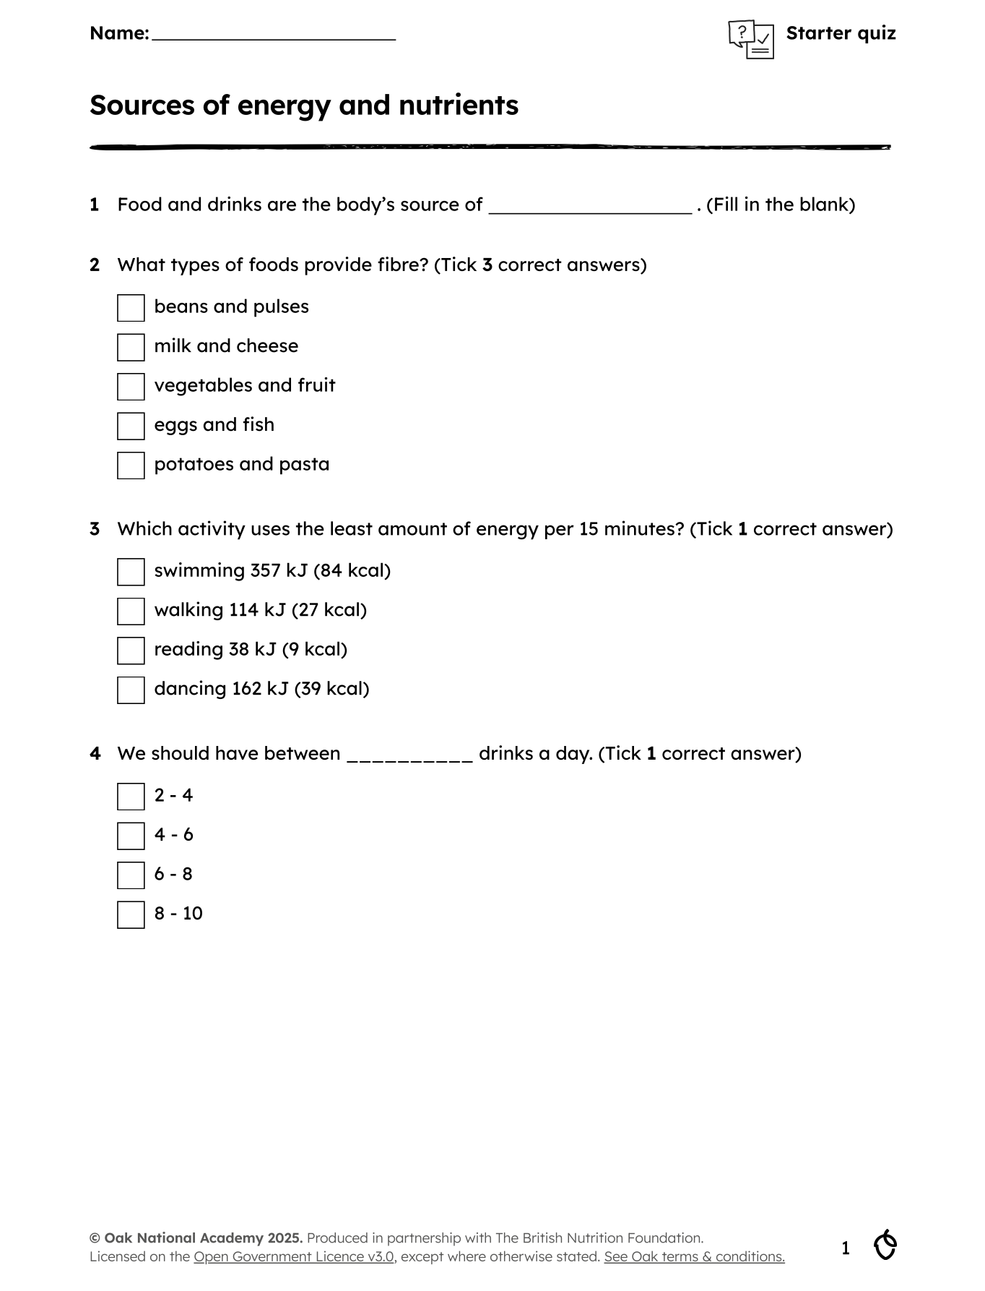
Primary – additional needs
Empowering pupils: Using Oak for independent and home learning
Supporting pupil self-study with Oak
Overview of self-study materials:
a) recipes - making simple dishes to enhance food skills
b) worksheets and quizzes - comprehension, vocabulary and reflection tasks
c) video lessons - teacher-led instruction
d) lesson slides -
e) interactive quizzes - check understanding and boost retention
Embedding Oak materials in your class
Supporting homework and home learning
Building pupil independence skills
Reviewing your CPD opportunities
Next steps
Access now

Slide 16
Primary - resources
Click an option:
units and lessons
subject content
slides & videos
recipes
assessment
independent leaners

Slide 17
Primary – units and lessons
Oak: Key Stage 1
A fully sequenced and coherent curriculum plan, which is flexible, accessible and diverse.
There are 24 lessons available, 12 each year (1 & 2).
The lessons are delivered in units; there are four units a year.
All lessons and resources are flexible – only use what you want.
All content covers National Curriculum D&T: Cooking and nutrition.
Subject content includes: healthy eating, cooking, and where food comes from.
Food – a fact of life: Key Stage 1
There is a 5-7 years area to support pupils.
Primary food projects set tasks around healthy eating, cooking, and here food comes from.
Knowledge organisers set out key learning.
Roadmaps give a visual guide to food and nutrition education.
View on Oak

Slide 18
Primary – units and lessons
Oak: Key Stage 2
A fully sequenced and coherent curriculum plan, which is flexible, accessible and diverse.
here are 48 lessons available, 12 each year (3, 4, 5 & 6).
The lessons are delivered in units; there are four units a year.
All lessons and resources are flexible – only use what you want.
All content covers National Curriculum D&T: Cooking and nutrition.
Subject content includes: healthy eating, cooking, and where food comes from.
Food – a fact of life: Key Stage 2
There is a 7-11 years area to support pupils.
Primary food projects set tasks around healthy eating, cooking, and here food comes from.
Knowledge organisers set out key learning.
Roadmaps give a visual guide to food and nutrition education.
View on Oak

Slide 19
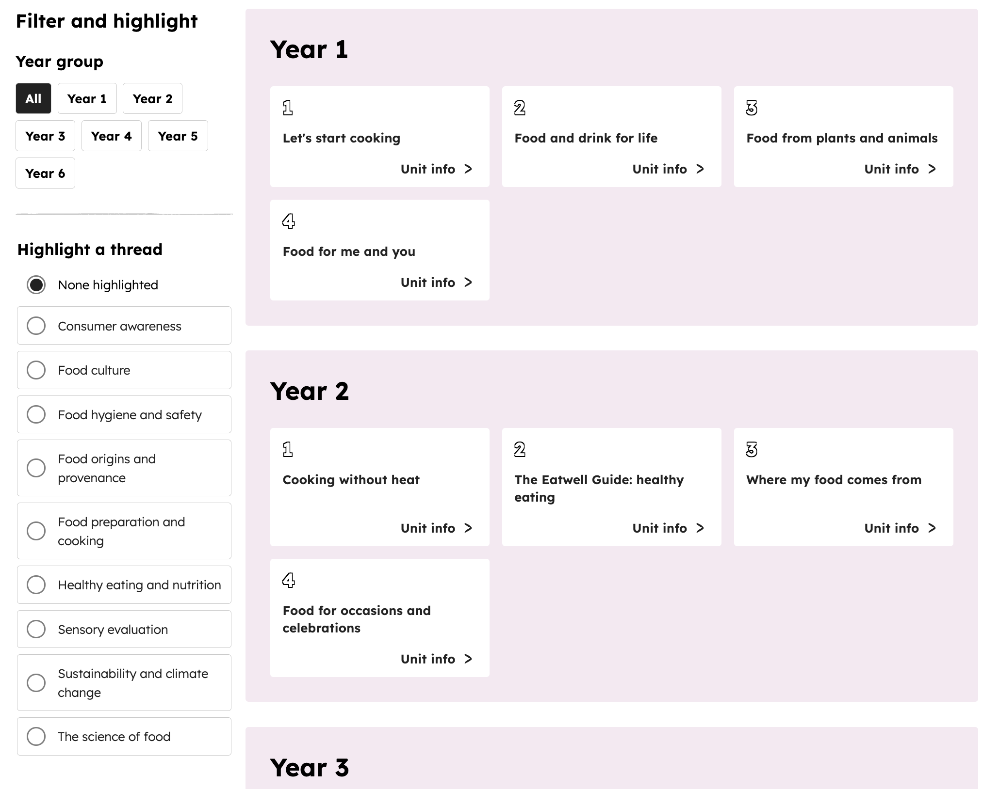
Primary – subject content
Oak subject content
All content covers National Curriculum D&T: Cooking and nutrition.
Main subject content includes: healthy eating, cooking, and where food comes from.
In addition, ‘threads’ throughout the curriculum (KS1 to 3) have been weaved in, supporting progression.
‘Threads’ include consumer awareness, food culture, food hygiene and safety, food origins and provenance, food preparation and cooking, healthy eating and nutrition, sensory evaluation, sustainability and climate change, and the science of food.
View on Oak

Slide 20
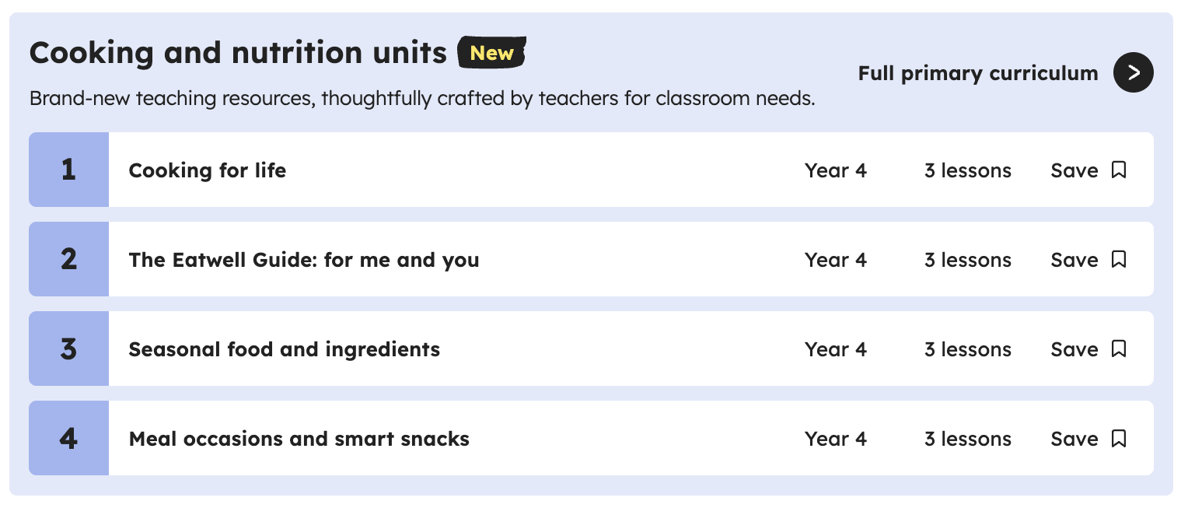
Primary – subject content
Oak subject content
In each year, there are 4 units. Progression is built in throughout the year, as well as over Key Stages.
For example, ‘cooking’ units in primary are: Let’s start cooking, Cooking without heat, Cooking around the world, Cooking for life, Creative cooking, and Cooking showcase.
Generally, each year group comprises:
  Unit 1: food preparation and cooking (3 lessons)
  Unit 2: healthy eating and nutrition (3 lessons)
  Unit 3: food origins and provenance (3 lessons)
  Unit 4: social context and dimension (3 lessons)
Food – a fact of life: subject content
There are resources, tasks and support for KS1 and KS2 in healthy eating, cooking, and where food comes from.
Primary food projects set tasks around healthy eating, cooking, and here food comes from.
Food route provides a journey of learning for pupils at KS1 and KS2.
Knowledge organisers set out key learning.
Learn with stories cover the curriculum through stories, with many supportive resources.
View on Oak

Slide 21
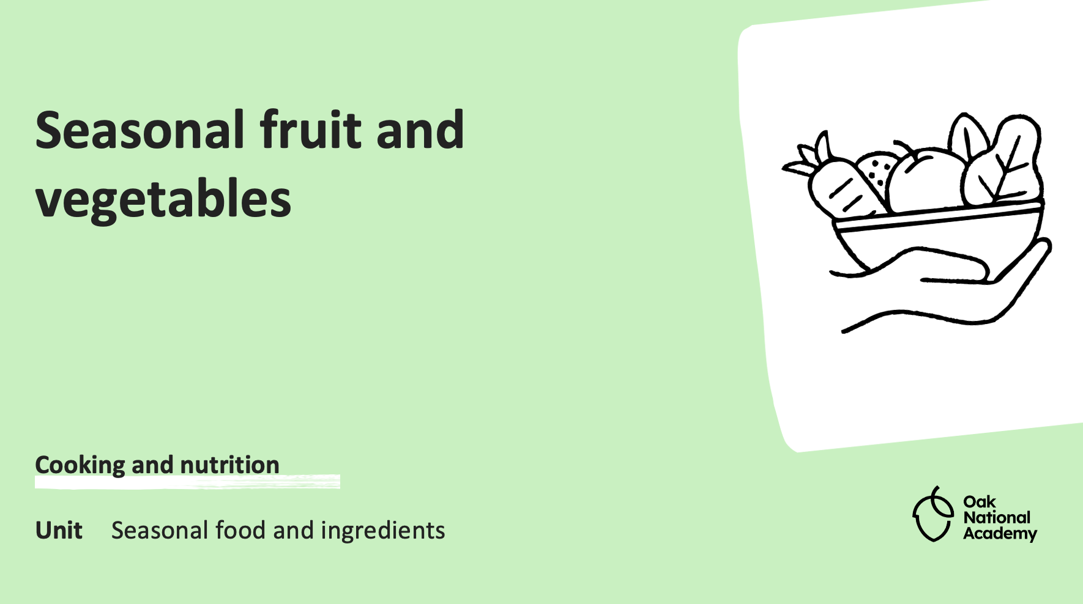
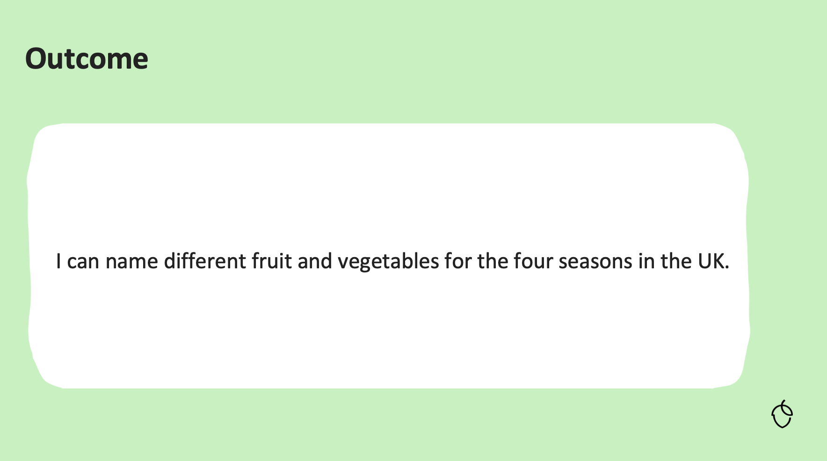
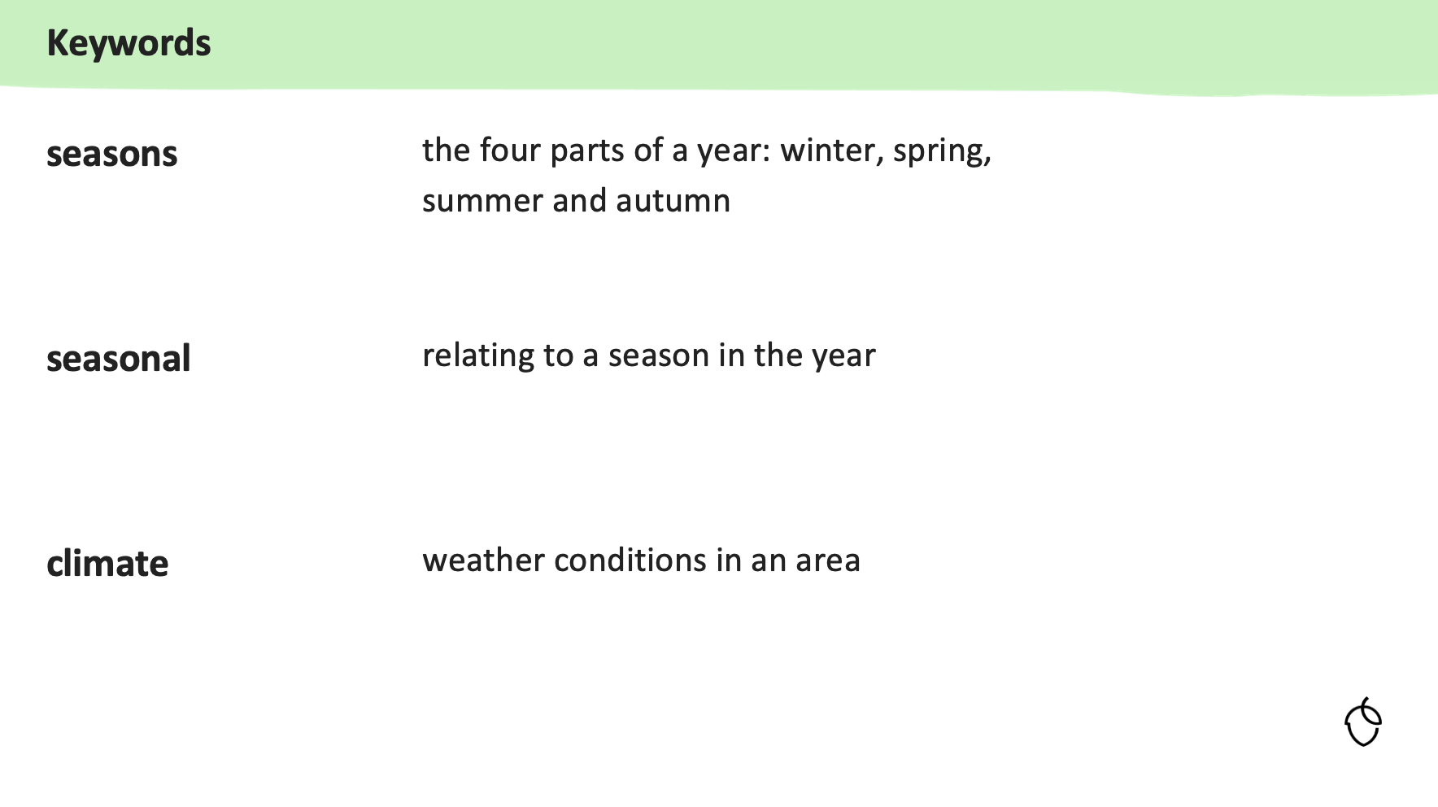
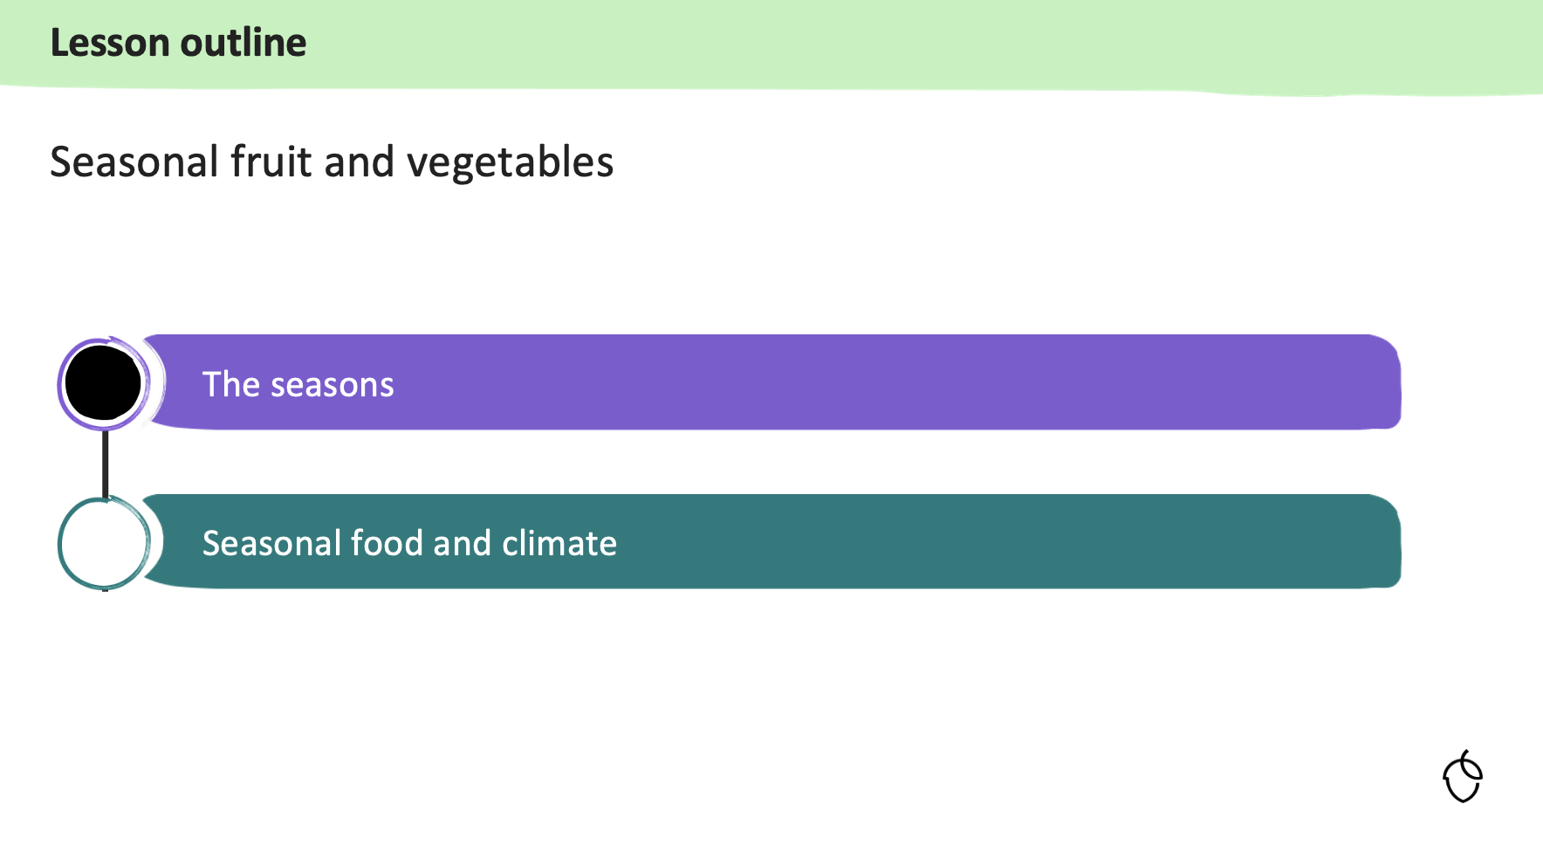
Primary – slides & videos
Oak: Slides
Each of the 72 primary lessons has a slide deck (PowerPoint/ Google Slide).
The slide deck provides all the detail for the lesson, broken into ‘learning cycles’, helping not to overload pupils.
Slides start with a pupil outcome and key words, and end with a summary.
Throughout the slide deck, ‘checks for understanding’ are provided, supporting pupils' retention.
At the end of each ‘learning cycle’ a task is provided (the task also appears on the pupil worksheet).
The slide decks are completely editable – use what you want. For example, you might use the entire deck, or a selected slide to support an existing lesson.
Food – a fact of life: slides
There are lots of slides available for KS1 and KS2 teaching in healthy eating, cooking, and where food comes from age phase sections.
View on Oak

Slide 22
Primary – slides & videos
Oak: Videos
Each of the 72 primary lessons has a video.
The video is a complete presentation of the entire lesson by a food and nutrition teacher.
The teacher goes through all the slides, asks questions and sets tasks (asking the teacher/pupil to pause the video), and discusses the answers.
The videos could be used in a variety of settings:
  in class, with pupils following and answering questions, guided by the teacher
  independent study, using the worksheet (where appropriate as homework)
  as part of a CPD session, for example to cover new food skills or explore how concepts are explained.
View on Oak
Food – a fact of life: videos
There are a range of videos to support food skills and cooking, as well as food and farming.

Slide 23
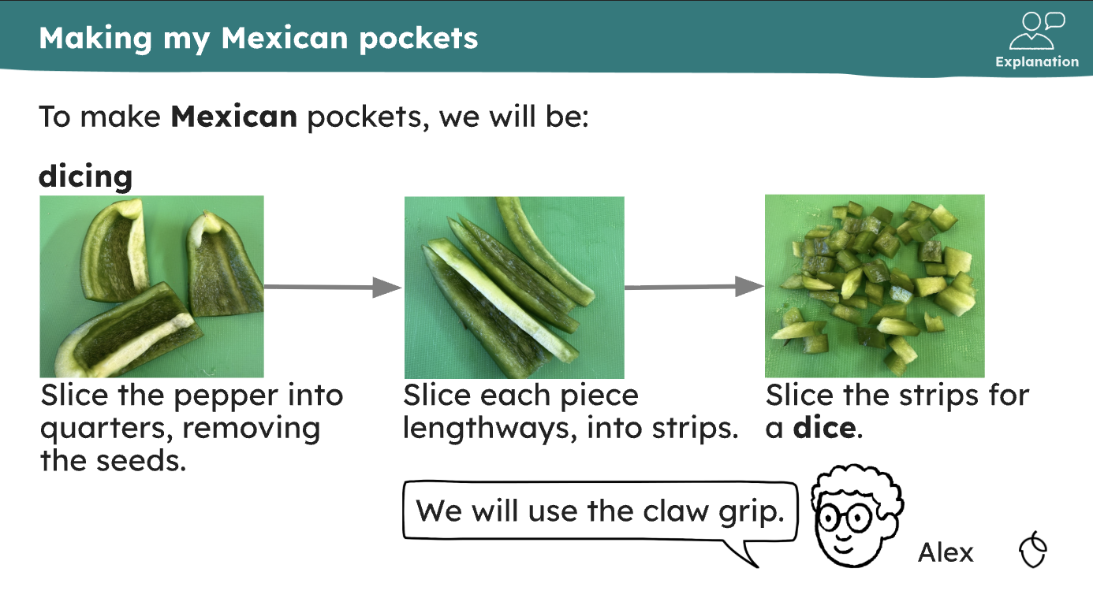
Primary – recipes
Oak: recipes
Each year group has 12 lessons, six of which are ‘practical’ (e.g. cooking), making a total of 36 practical lessons in primary.
At Key stage 1, all lessons (and therefore recipes) are ‘non-heat’, and predominately savoury (there is one sweet recipe per year group).
At Key stage 2, lessons include heat and are predominately savoury.
Food skill progression has been built into the lessons, based on research evidence and published frameworks, and pupil motor skill development.
All recipes are found within each lesson. They are in the slide deck, pupil worksheet and teacher additional information.
The slide deck goes through the food skills for each recipe.
View on Oak

Slide 24
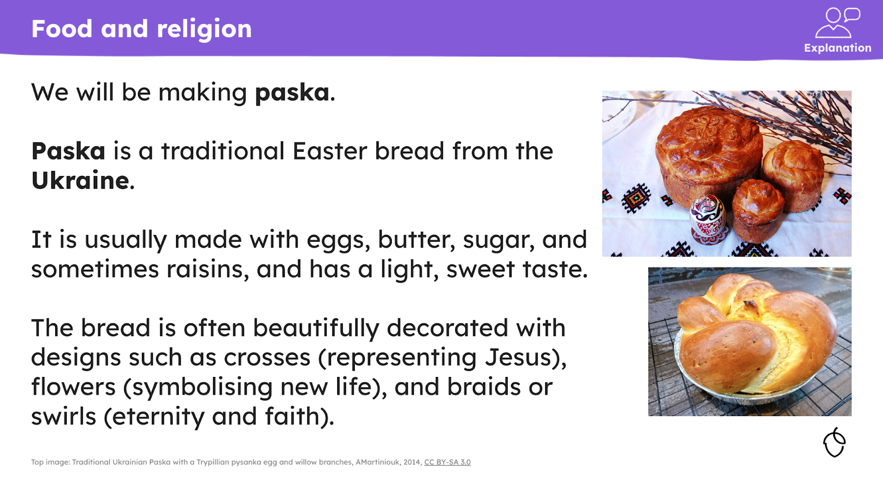
Primary – recipes
Oak: recipes
All recipes are flexible and can be edited.
Most provide opportunities for pupils to be creative.
Recipes are plant-rich, with options for fish and meat to be added.
In the ‘additional materials’ (teacher support), there is additional advice and support, including modifying the recipes for those with allergies, or following vegan or vegetarian diets. In addition, classroom management tips are given such as pupils working groups, or sharing pieces of equipment.
Recipes link to other learning, such as health or food origins, as well as exploring the social context and dimension of food.
A range of recipes have been included, celebrating diversity and inclusivity.
Food – a fact of life: recipes
Discover a selection of recipes designed to support your teaching.
View the ‘top 25’ recipes, updated with extra support.
View on Oak

Slide 25
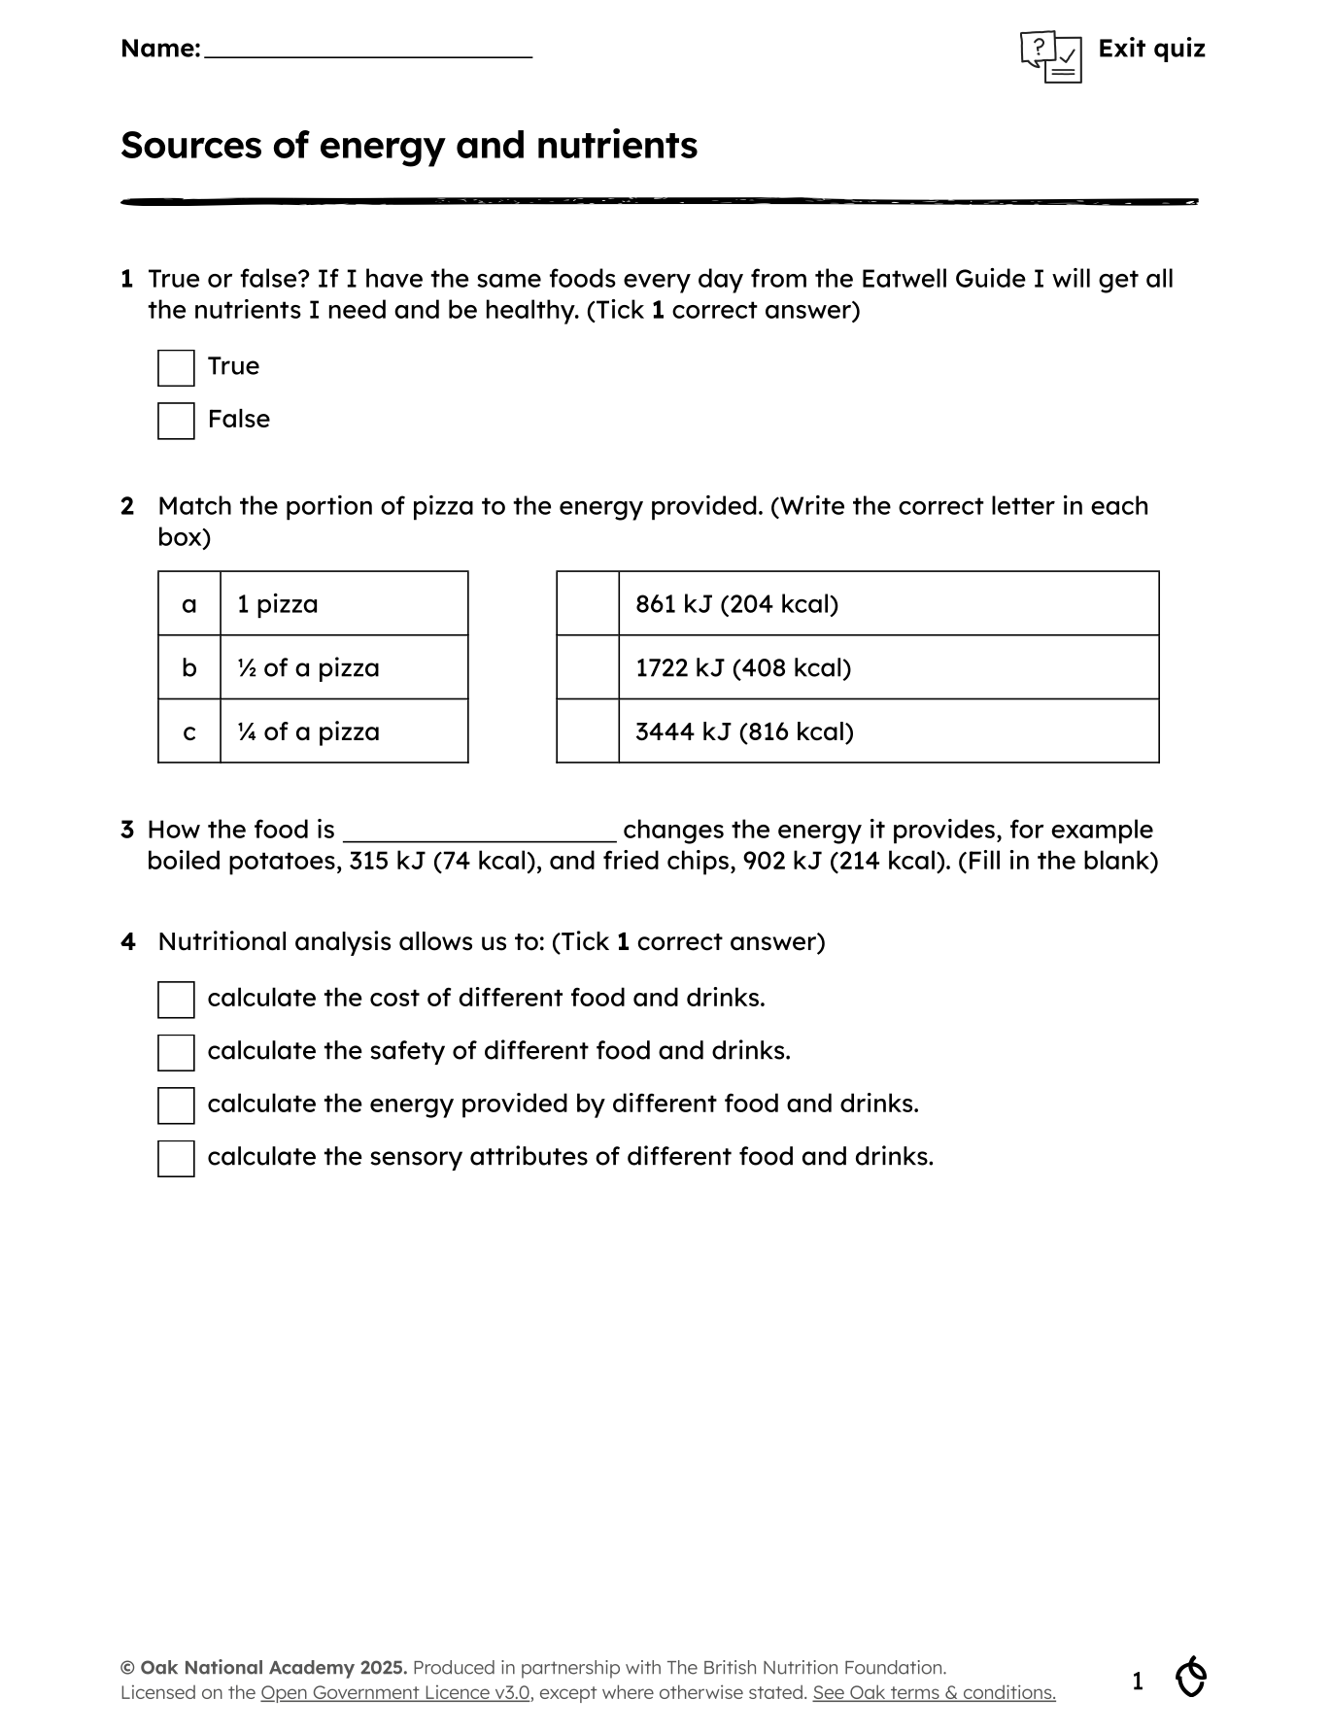
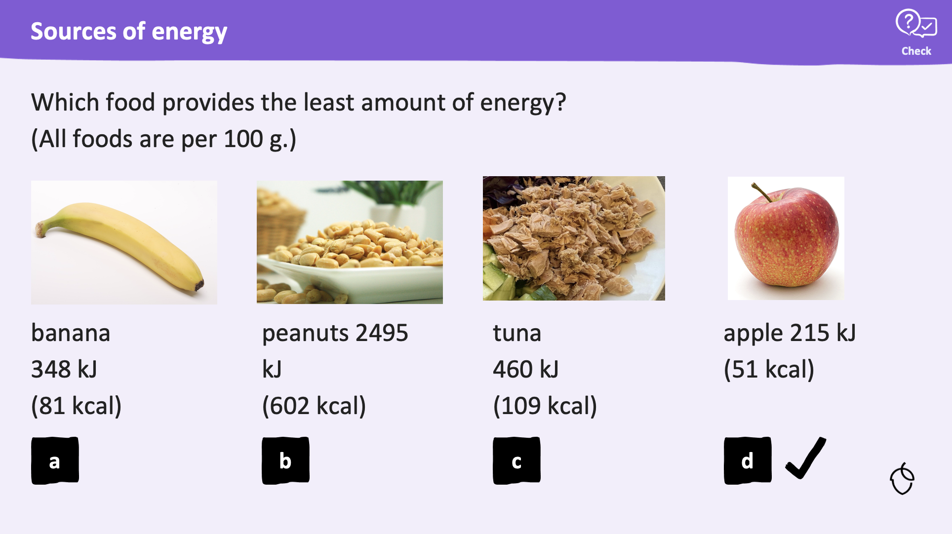
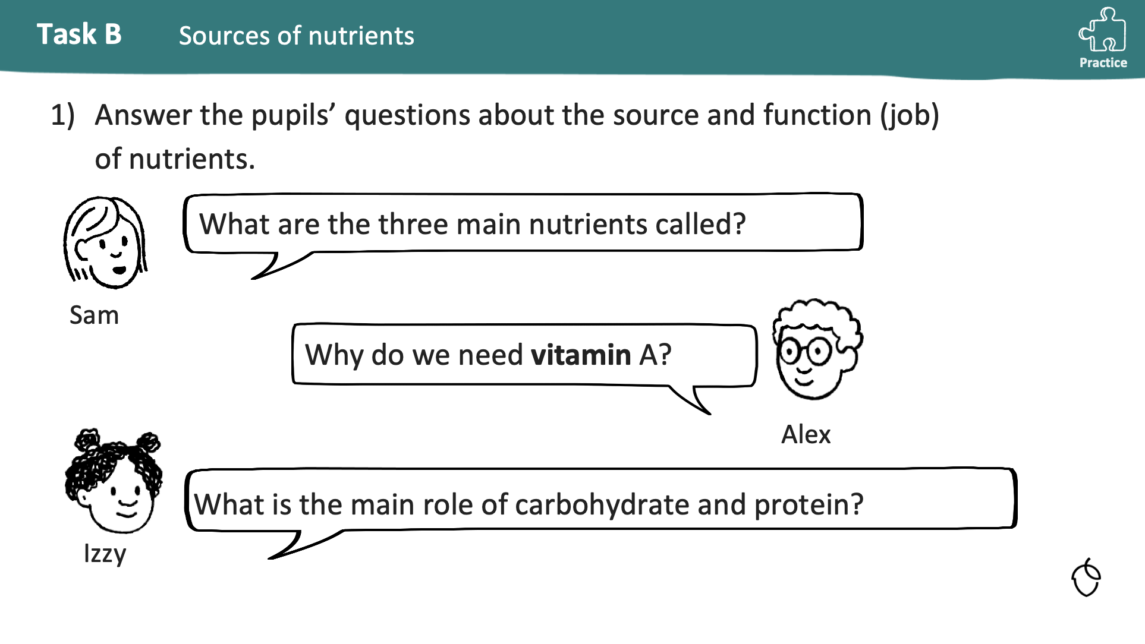
Primary – assessment
Oak: assessment
Each lesson has several assessment points which could be used in your own teaching.
Key assessment points
  Starter quiz – available as a worksheet, which pupils could complete before/at the start of the lesson to check prior knowledge. An answer sheet is also provided. Quizzes are found with each lesson
  Exit quiz - will test your pupils' understanding of the key learning points. An answer sheet is also provided. Quizzes are found with each lesson.
  ‘Checks for understanding’ - each ‘learning cycle’ in a lesson features explanations with ‘checks for understanding’
  ‘Tasks’ - each ‘learning cycle’ in a lesson includes a practice task
  Worksheets – this has the ‘tasks’ from the lesson, in a format that can easily be completed by the pupil.
View on Oak

Slide 26
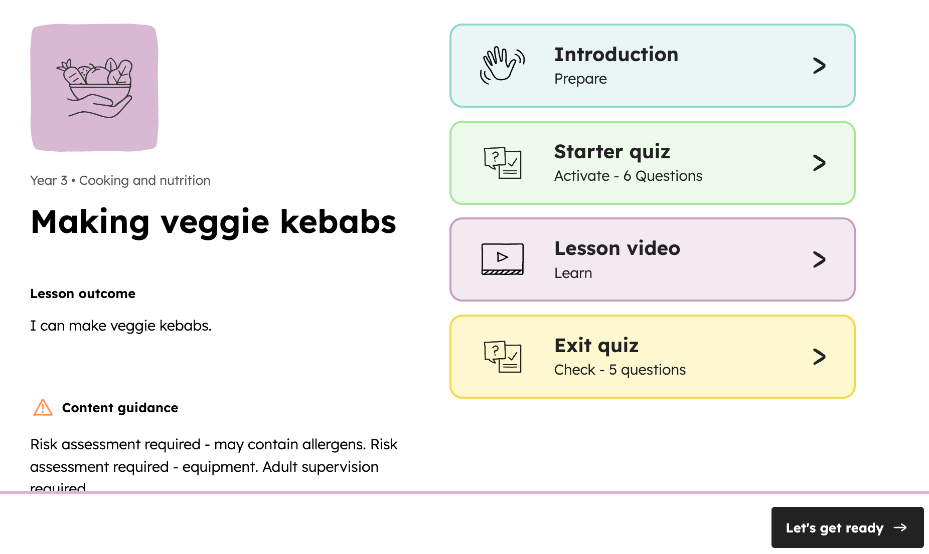
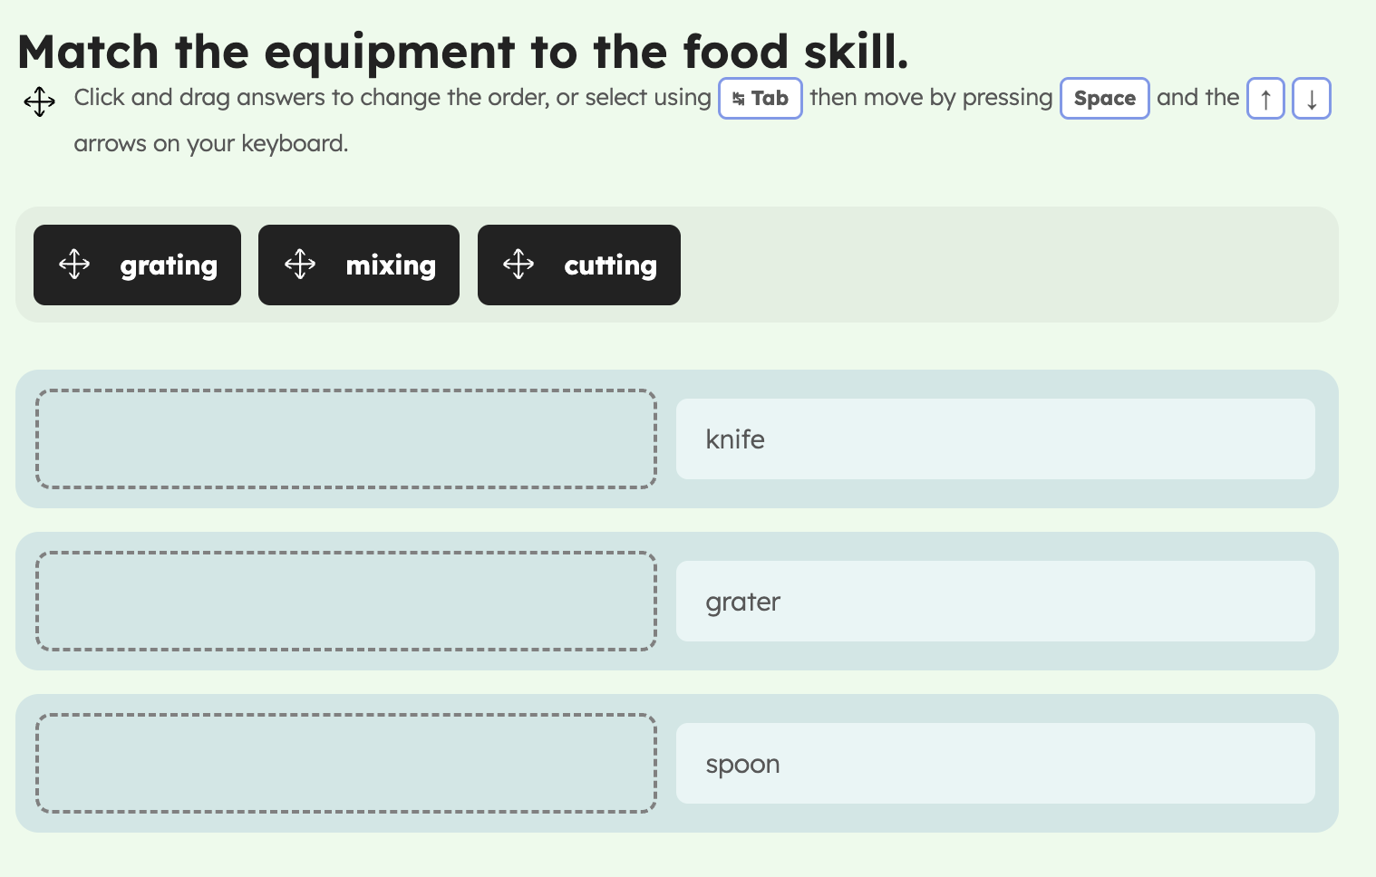
Primary – assessment
Oak: online support
There is a pupil area on the Oak National Academy website.
Pupils can select their year group, subject, unit and then lesson.
You could give pupils the direct link to the unit or lesson.
Pupils are provided with:
  Introduction (details about the lesson, plus a worksheet download)
  Starter quiz (online questions – their score is highlighted)
  Lesson video (they could play the video, using the worksheet)
  Exit quiz (online questions – their score is highlighted)
At the end, there is the option to print the results (useful as evidence), as well as share the ‘link’ with the teacher (where appropriate).
Food – a fact of life: assessment and online
There are worksheets and assessment tools for KS1 and KS2 in the healthy eating, cooking, and where food comes from sections.
Check out the interactivity activities to support healthy eating and cooking.
View on Oak

Slide 27
Primary – independent learners
Oak: independent learners
When pupils are ready, there are several ways the Oak materials can be used to support independent learning.
For example pupils could:
  take the starter quiz
  watch the lesson video
  answering the ‘checks for understanding’, pausing the video when instructed
  complete the worksheet of tasks
  take the exit quiz
View on Oak

Slide 28
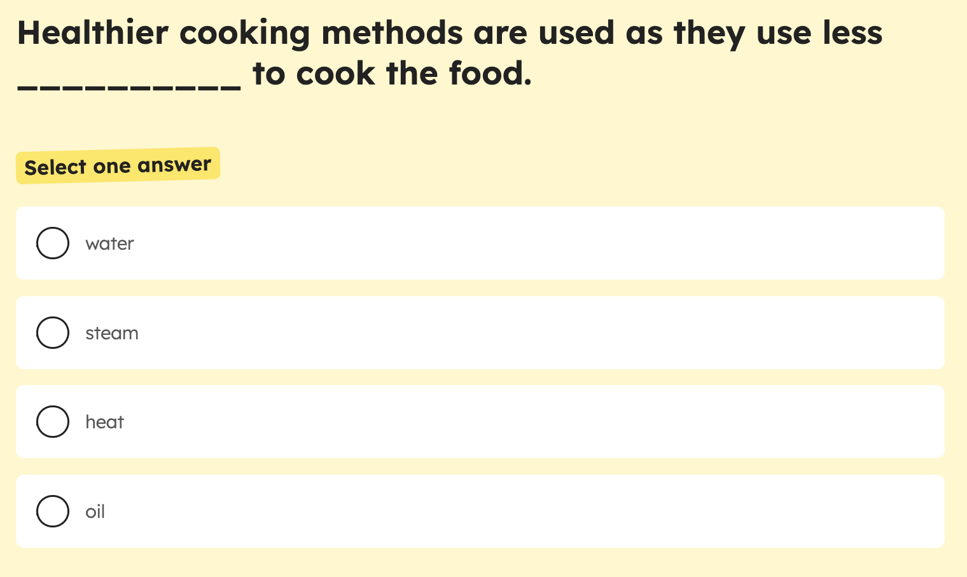
Primary – independent learners
Oak: online support
There is a pupil area on the Oak National Academy website.
Pupils can select their year group, subject, unit and then lesson.
You could give pupils the direct link to the unit or lesson.
Pupils are provided with:
  Introduction (details about the lesson, plus a worksheet download)
  Starter quiz (online questions – their score is highlighted)
  Lesson video (they could play the video, using the worksheet)
  Exit quiz (online questions – their score is highlighted)
At the end, there is the option to print the results (useful as evidence), as well as share the ‘link’ with the teacher (where appropriate).
Food – a fact of life: independent learners
Use the Food route activity charts for pupils in KS1 and KS2.
Get creative with the Learn with stories.
View on Oak

Slide 29
Secondary: What area do you want to explore?
Click an option:
training
resources

Slide 30
Secondary - training
Click an option:
explore Oak
plan your CPD
create your SoL
secondary focus
assessment
additional needs

Slide 31
Secondary – explore Oak
Getting started with Oak: What the new food curriculum offers you
• Welcome and purpose of the Oak food curriculum
• Curriculum overview and structure
• Explore key principles: knowledge and vocabulary rich, sequenced and coherent, flexible, accessible, diverse and evidence-informed
• Overview of lessons and materials available
• Practical guidance and demonstration - how to access everything for free
• Implementation in your school
• Next steps for you
Access now

Slide 32
Secondary – explore Oak
Inside the curriculum: Unpacking Oak’s approach to food
Curriculum aims and purpose, including aspects of practical work, health and sustainable eating, and cultural appreciation
Curriculum structure, threads, units and lessons, within a social context
Exploring the 108 lessons: slides, videos, worksheets, quizzes, recipes, and teacher support materials
Practical food work and embedding knowledge
Support and resources available for FREE for you
Next steps for you
Access now

Slide 33
Secondary – plan your CPD
Map your own path: Planning CPD that works for you and your team
Exploring Oak's curriculum and teaching resources
Using Oak materials for CPD development
  lesson videos: watch to observe pedagogy, vocabulary use, modelling
  lesson slides, quizzes and worksheets: reflect on what subject knowledge teachers need to support these
  recipes: opportunities for departmental practice, rehearsal, resource planning
Planning your own CPD using interactive tools
  competence rating and personalised plans
  SMART goal setting
Next steps for you
Access now

Slide 34
Secondary – plan your CPD
10 CPD Courses
There are 10 different Oak courses available to support your professional development. Review each to see which is most appropriate for your needs.
Getting started with Oak: What the new food curriculum offers you
Map your own path: Planning CPD that works for you and your team
Inside the curriculum: Unpacking Oak’s approach to food
Primary food teaching made easy with Oak
Bringing Oak to life in secondary food lessons
Making Oak work in primary: Practical tips for the classroom
Making Oak work in secondary: Strategies for success
Designing a modern food curriculum with Oak as your foundation
Inclusive food education: Adapting Oak for learners with additional needs
Empowering pupils: Using Oak for independent and home learning
Access now

Slide 35
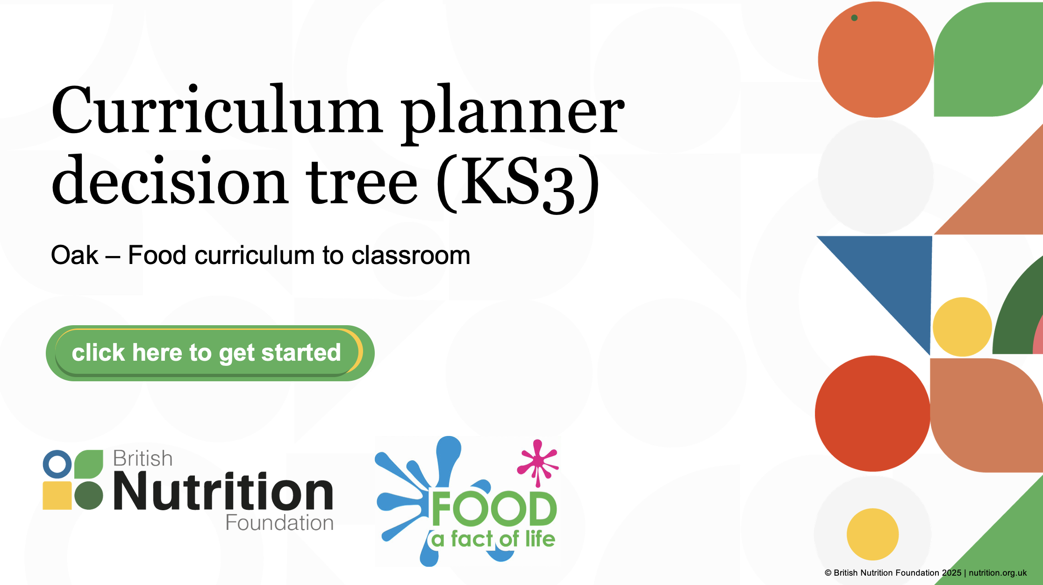
Secondary – create your SoL
Designing a modern food curriculum with Oak as your foundation
Exploring a modern food curriculum
Recipe diversity and Oak
The social context and dimension of food
Planning and mapping progression across the Key Stages
Using tools, planners and AI to build great lessons with rigour
Reviewing your CPD opportunities
Next steps
Access now

Slide 36
Secondary – create your SoL
Making Oak work in secondary: Strategies for success
An overview of the Oak food curriculum for KS3
How Oak supports good food teaching
What is available for you and your school
Pragmatic approaches to:
a) deciding what, why and how to teach
b) planning and managing cooking sessions
c) dealing with allergies
d) covering curriculum content
e) time and resource constraints and opportunities
Discover instant support for your pupils
Review your CPD opportunities
Next steps
Access now

Slide 37
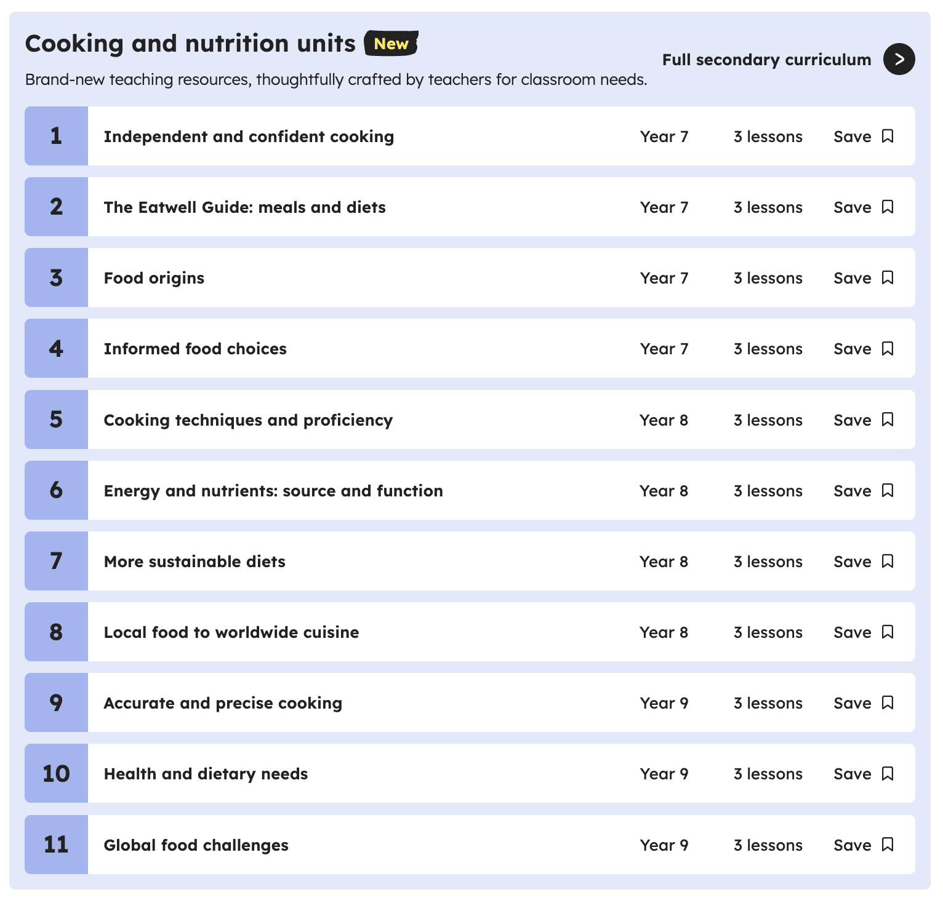
Secondary – secondary focus
Bringing Oak to life in secondary food lessons
• The Oak food curriculum structure, threads, units and lessons
• Exploring KS3 lessons: slides, videos, worksheets, quizzes, recipes, and teacher support materials
• Discover free editable resources for use in the classroom - Year 7 to Year 9 (36 lessons in total)
• Practical guidance and demonstration of the website and resources available
• Explore support for your pupils
• Review CPD opportunities for you
• Support and resources available for FREE for you
• Next steps for you
Access now

Slide 38
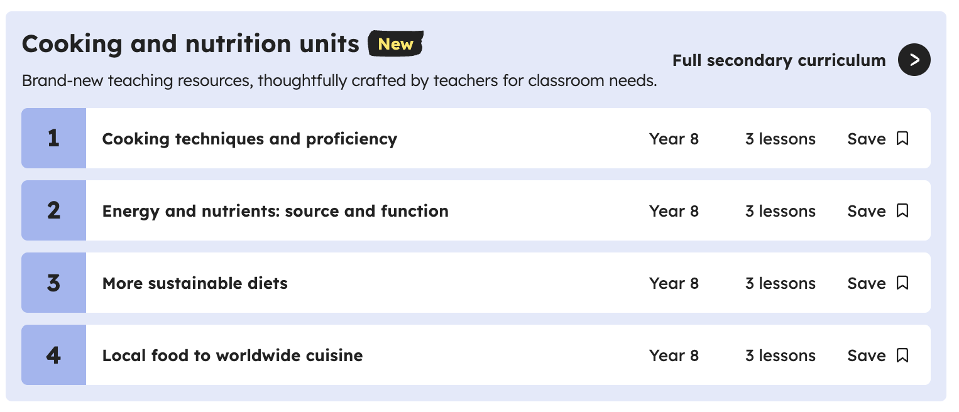
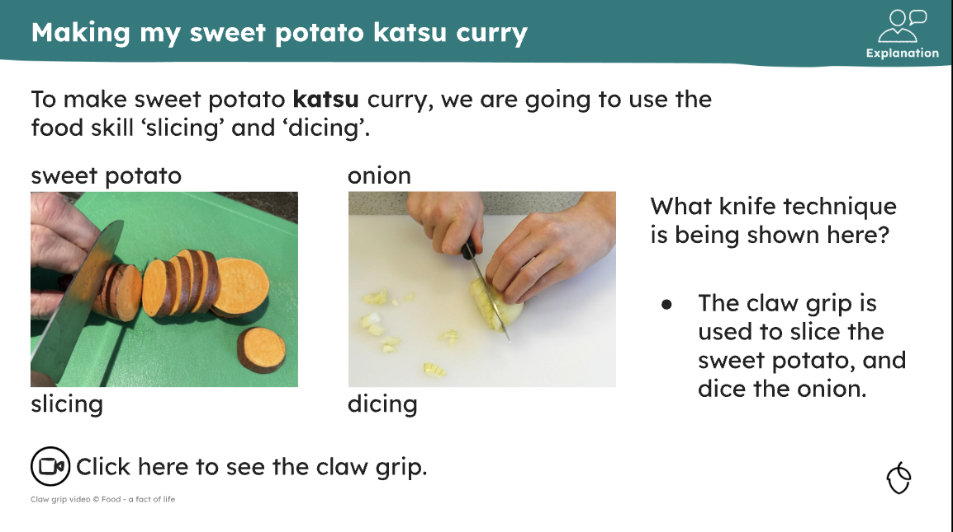
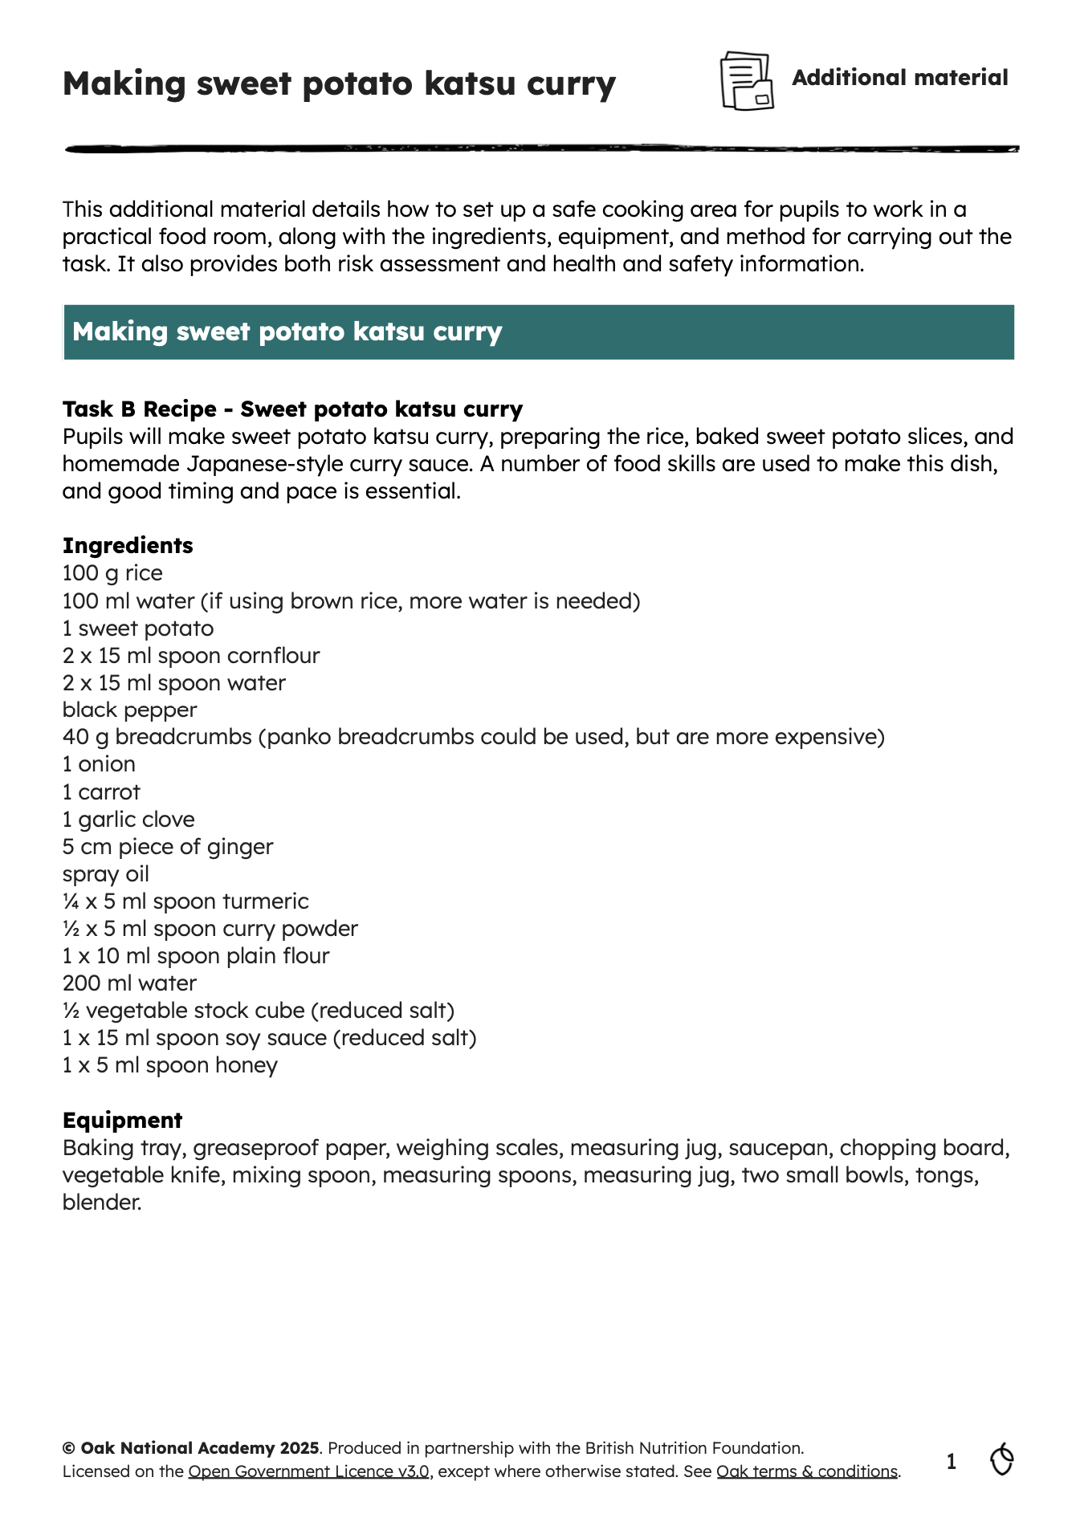
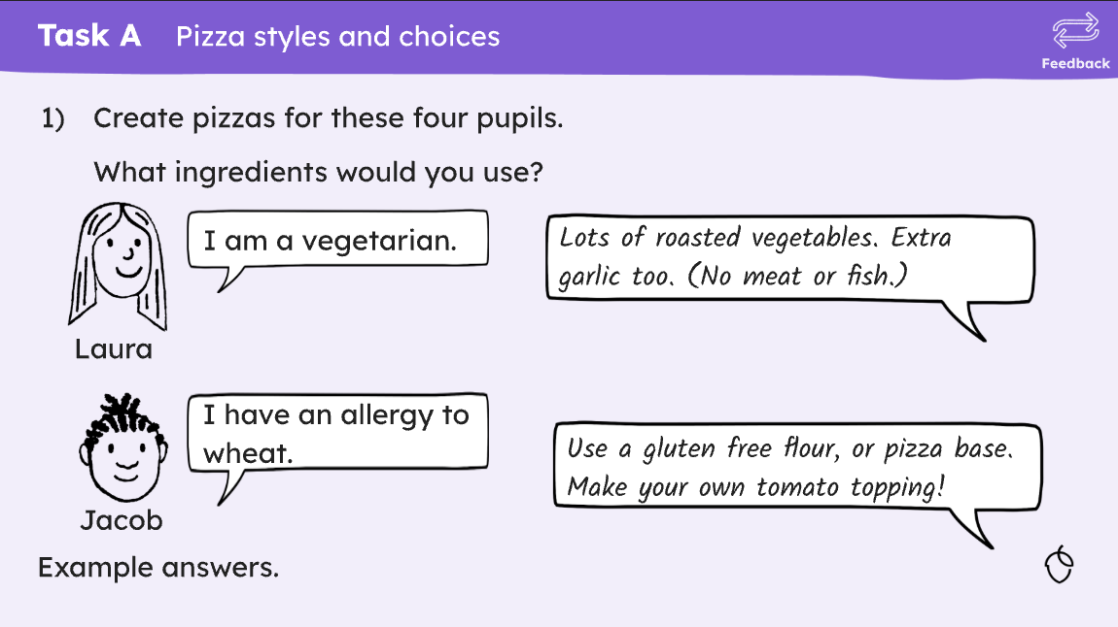
Secondary – secondary focus
Making Oak work in secondary: Strategies for success
• An overview of the Oak food curriculum for KS3
• How Oak supports good food teaching
• What is available for you and your school
• Pragmatic approaches to:
a) deciding what, why and how to teach
b) planning and managing cooking sessions
c) dealing with allergies
d) covering curriculum content
e) time and resource constraints and opportunities
• Discover instant support for your pupils
• Review your CPD opportunities
• Next steps
Access now

Slide 39
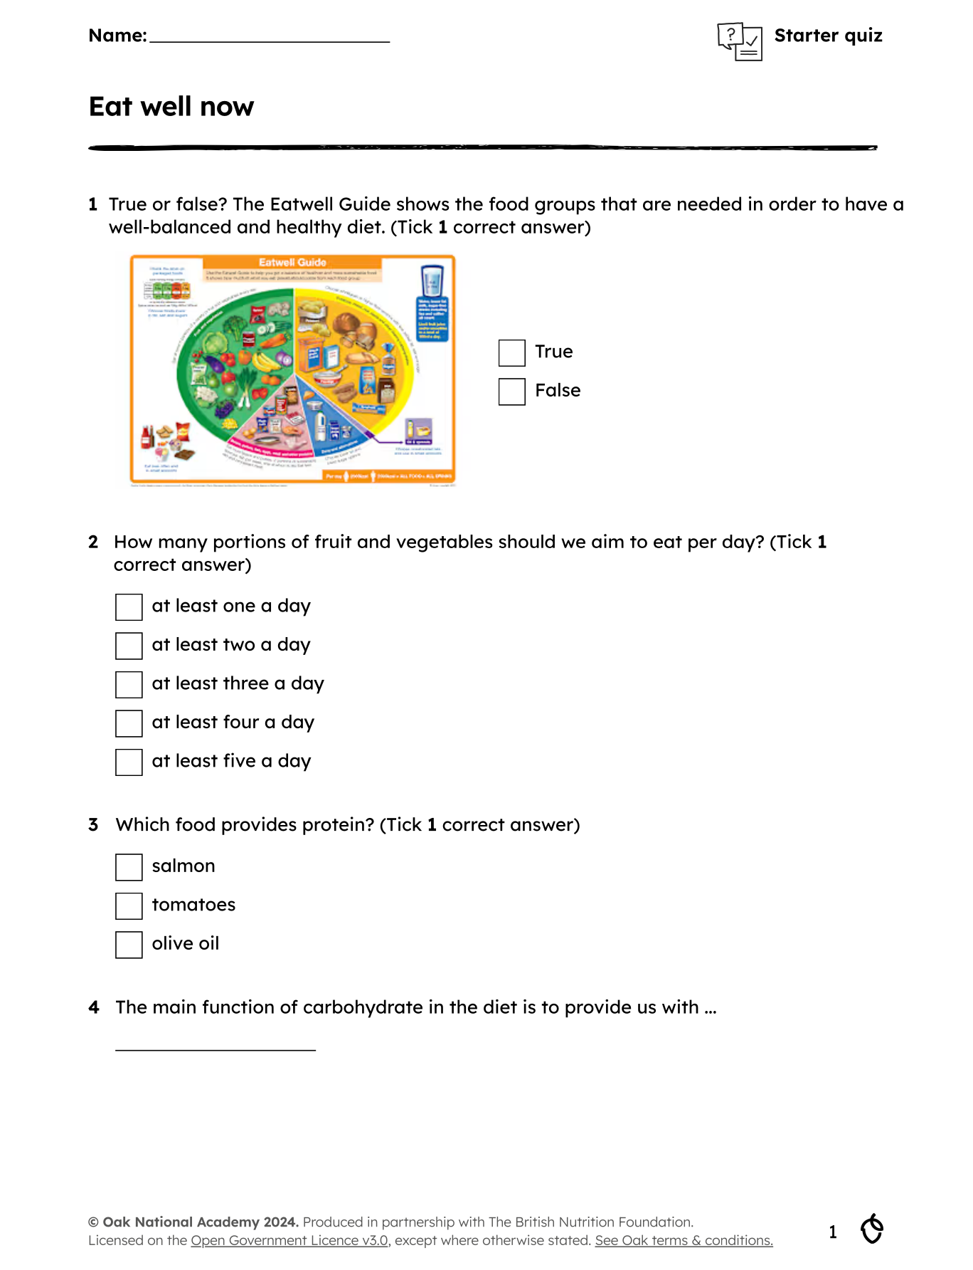
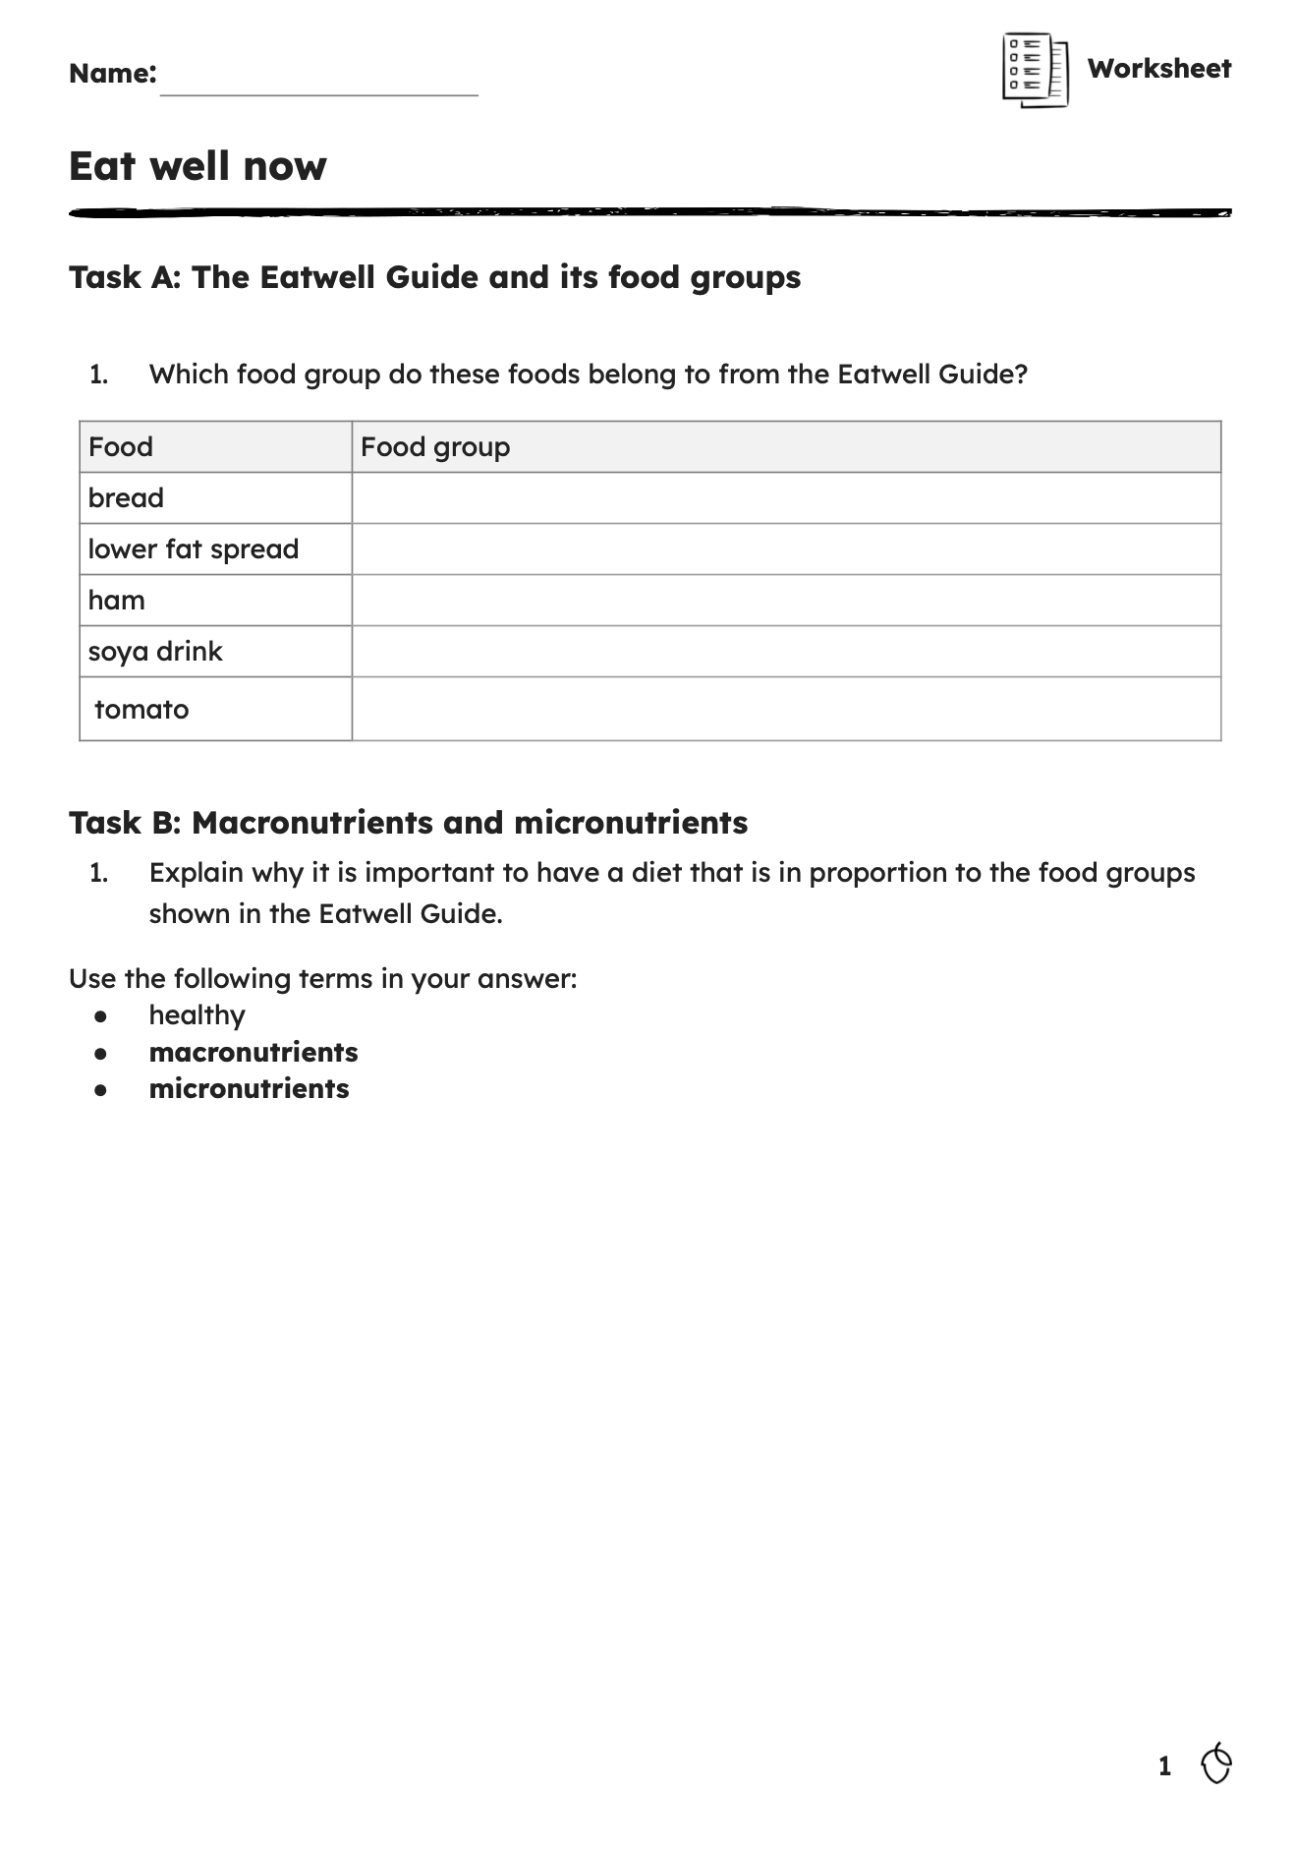
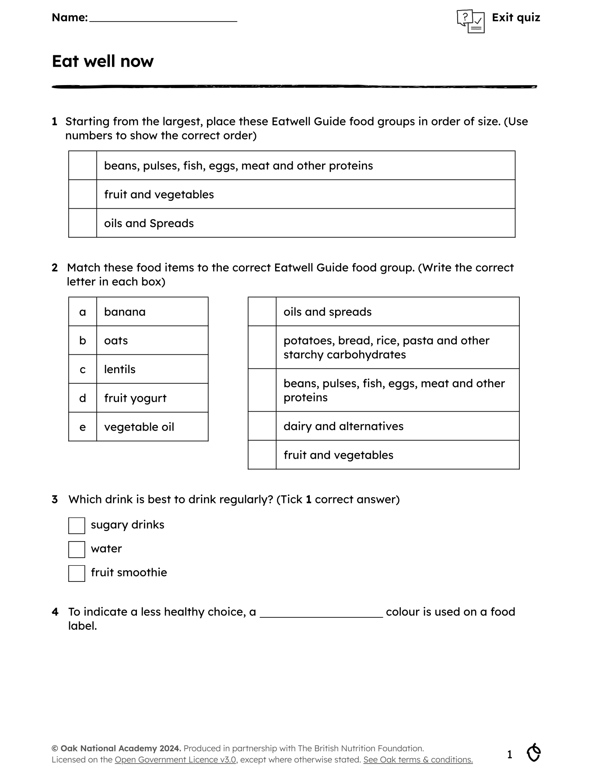
Secondary – assessment
Empowering pupils: Using Oak for independent and home learning
• Supporting pupil self-study with Oak
• Overview of self-study materials:
a) recipes - making simple dishes to enhance food skills
b) worksheets and quizzes - comprehension, vocabulary and reflection tasks
c) video lessons - teacher-led instruction
d) lesson slides -
e) interactive quizzes - check understanding and boost retention
• Embedding Oak materials in your class
• Supporting homework and home learning
• Building pupil independence skills
• Reviewing your CPD opportunities
• Next steps
Access now

Slide 40
Secondary – assessment
Making Oak work in secondary: Strategies for success
An overview of the Oak food curriculum for KS3
How Oak supports good food teaching
What is available for you and your school
Pragmatic approaches to:
a) deciding what, why and how to teach
b) planning and managing cooking sessions
c) dealing with allergies
d) covering curriculum content
e) time and resource constraints and opportunities
Discover instant support for your pupils
Review your CPD opportunities
Next steps
Access now

Slide 41
Secondary – additional needs
Inclusive food education: Adapting Oak for learners with additional needs
• Adapting the Oak food curriculum for pupils with additional needs
• Curriculum strengths for learners, such as structure, progression, flexibility and clear vocabulary
• Practical ways of using and adapting Oak food lessons and materials
• Reviewing your CPD opportunities
• Next steps
Access now

Slide 42
Secondary – additional needs
Empowering pupils: Using Oak for independent and home learning
Supporting pupil self-study with Oak
Overview of self-study materials:
a) recipes - making simple dishes to enhance food skills
b) worksheets and quizzes - comprehension, vocabulary and reflection tasks
c) video lessons - teacher-led instruction
d) lesson slides -
e) interactive quizzes - check understanding and boost retention
Embedding Oak materials in your class
Supporting homework and home learning
Building pupil independence skills
Reviewing your CPD opportunities
Next steps
Access now

Slide 43
Secondary - resources
Click an option:
units and lessons
subject content
slides & videos
recipes
assessment
independent leaners

Slide 44
Secondary – units and lessons
Oak: Key Stage 3
There are 36 lessons available, 12 each year (7, 8 & 9).
The lessons are delivered in units; there are four units a year.
All lessons and resources are flexible and editable – only use what you want.
All content covers National Curriculum D&T: Cooking and nutrition, as well as the Core food competences for children and young people.
Core subject content includes: healthy eating, cooking, and where food comes from. In addition, ‘threads’ across lessons include consumer awareness, food culture, food hygiene and safety, food origins and provenance, food preparation and cooking, healthy eating and nutrition, sensory evaluation, sustainability and climate change, and the science of food.
View on Oak

Slide 45
Secondary – units and lessons
Oak: Key Stage 3
In each year, there are 4 units. Progression is built in throughout the year, as well as over Key Stage.
Generally, each year group comprises:
  Unit 1: food preparation and cooking (3 lessons)
  Unit 2: healthy eating and nutrition (3 lessons)
  Unit 3: food origins and provenance (3 lessons)
  Unit 4: social context and dimension (3 lessons)
In each year group most lessons are practical, eight out of 12. The recipes used are predominately savoury (there is one sweet recipe per year group), plant-rich (with options for fish and meat), and celebrate diversity and inclusivity.
Food – a fact of life: Key Stage 3
There is a 11-14 years area to support pupils.
Scheme of Work for Year 7, 8 and 9, with detailed lesson plans, and Licence to Cook and Food route gives extra support.
Knowledge organisers set out key learning.
Roadmaps give a visual guide to food and nutrition education.
View on Oak

Slide 46
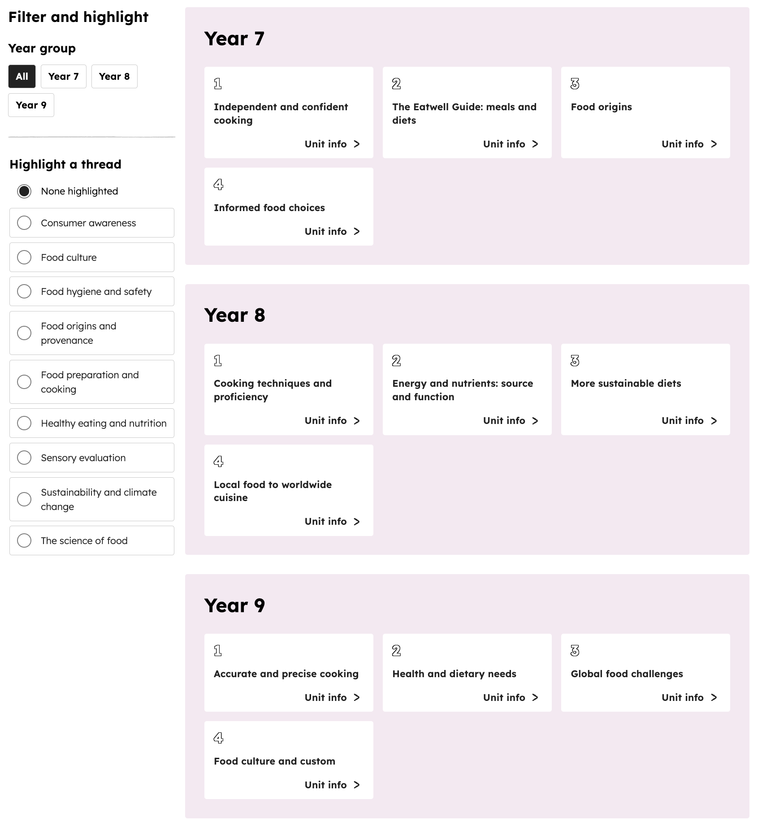
Secondary – subject content
Oak: subject content
All content covers National Curriculum D&T: Cooking and nutrition.
Main subject content includes: healthy eating, cooking, and where food comes from.
In addition, ‘threads’ throughout the curriculum (KS1 to 3) have been weaved in, supporting progression.
‘Threads’ include consumer awareness, food culture, food hygiene and safety, food origins and provenance, food preparation and cooking, healthy eating and nutrition, sensory evaluation, sustainability and climate change, and the science of food.
View on Oak

Slide 47
Secondary – subject content
Oak: subject content
In each year, there are 4 units. Progression is built in throughout the year, as well as over Key Stages.
For example, ‘cooking’ units in secondary are: Independent and confident cooking, Cooking techniques and proficiency, and Accurate and precise cooking.
In each year group most lessons are practical, eight out of 12. The recipes used are predominately savoury (there is one sweet recipe per year group), plant-rich (with options for fish and meat), and celebrate diversity and inclusivity.
All practical lessons embed other learning, such as health, food provenance, and/or food science.
Food – a fact of life: subject content
There are resources, tasks and support for KS3 in healthy eating, cooking, and where food comes from.
Scheme of Work for Year 7, 8 and 9, with detailed lesson plans, and Licence to Cook gives extra support.
Knowledge organisers set out key learning.
View on Oak

Slide 48
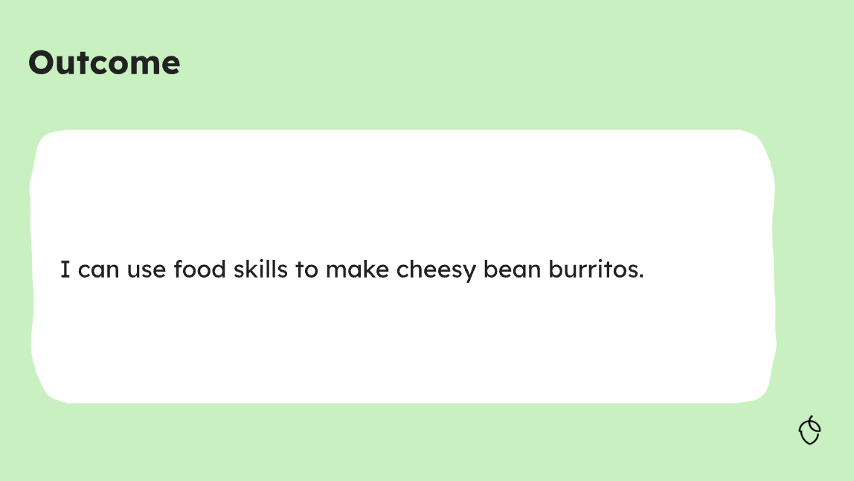
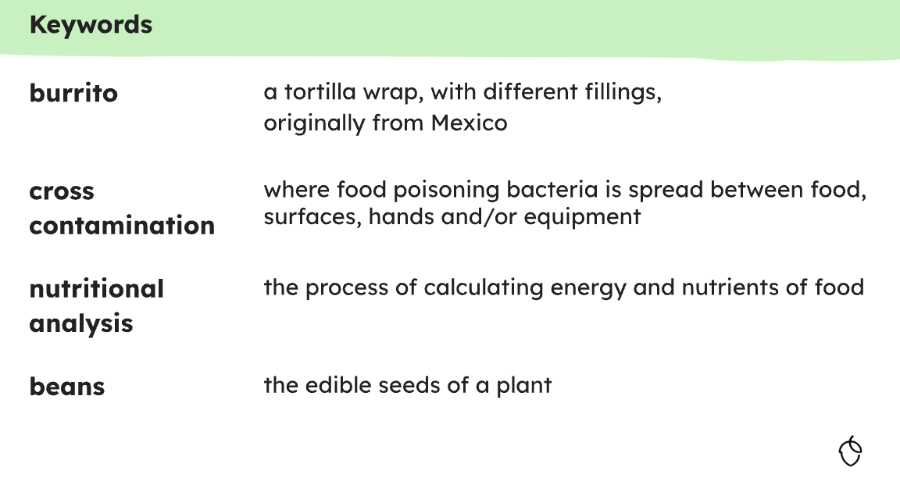
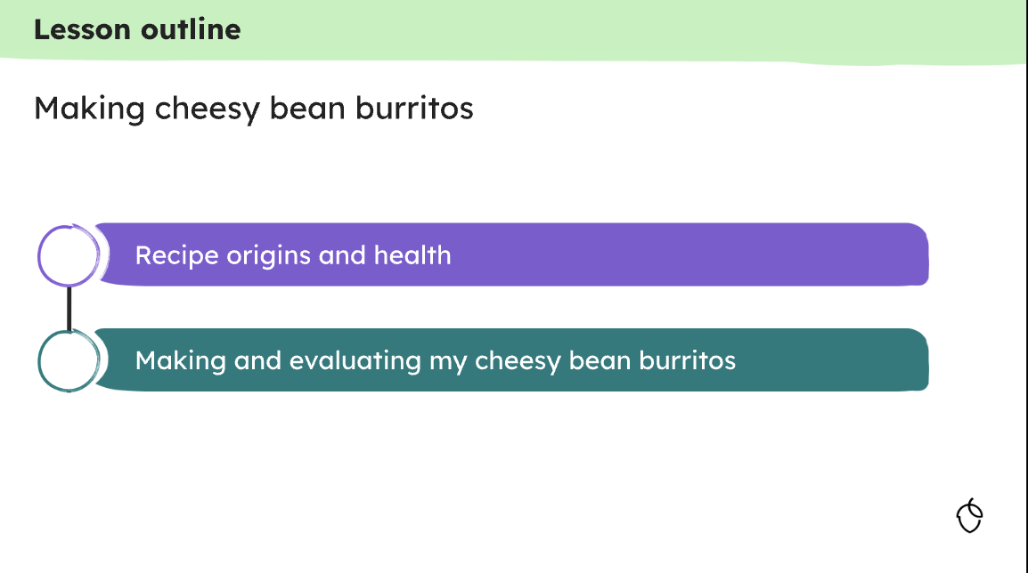
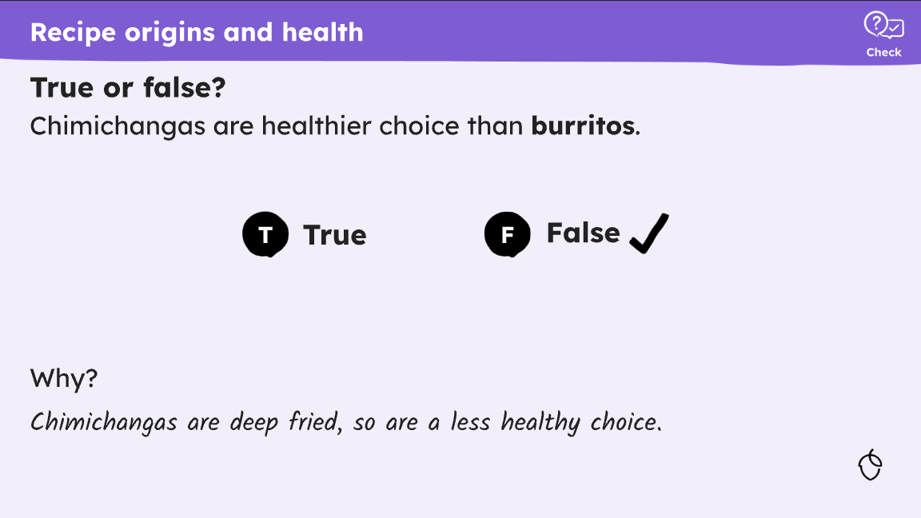
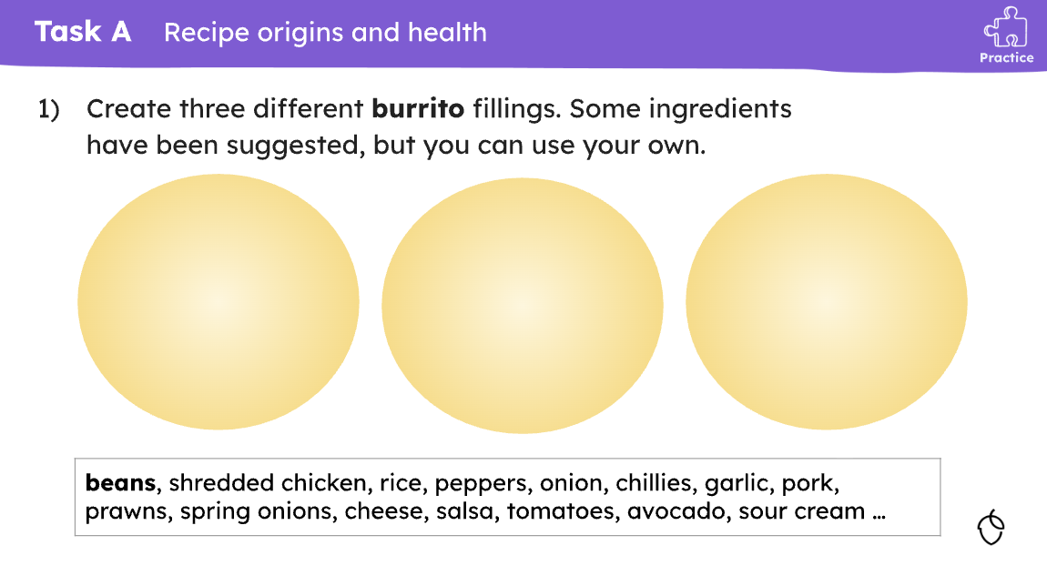
Secondary – slides & videos
Oak: slides
Each of the 36 secondary lessons has a slide deck (PowerPoint/Google Slide).
The slide deck provides all the detail for the lesson, broken into ‘learning cycles’, helping not to overload pupils.
Slides start with a pupil outcome and key words, and end with a summary.
Throughout the slide deck, ‘checks for understanding’ are provided, supporting pupils' retention.
At the end of each ‘learning cycle’ a task is provided (the task also appears on the pupil worksheet).
The slide decks are completely editable – use what you want. For example, you might use the entire deck, or a selected slide to support an existing lesson.
Food – a fact of life: slides
There are lots of slides available for KS3 teaching in healthy eating, cooking, and where food comes from age phase sections.
View on Oak

Slide 49
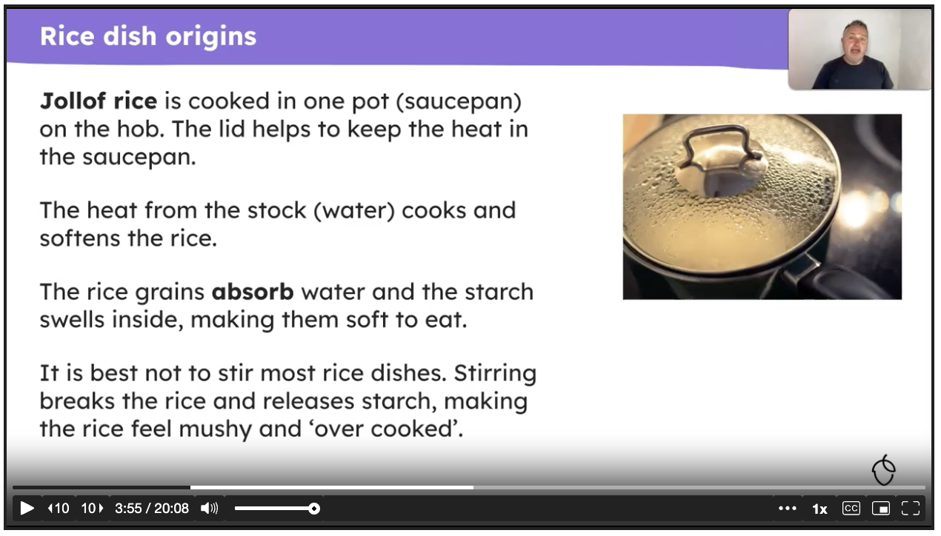
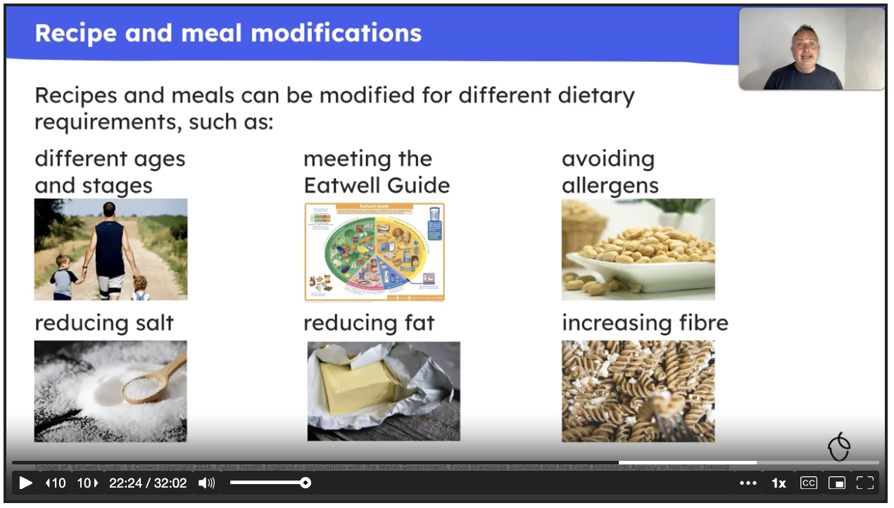
Secondary – slides & videos
Oak: videos
Each of the 36 secondary lessons has a video.
The video is a complete presentation of the entire lesson by a food and nutrition teacher.
The teacher goes through all the slides, asks questions and sets tasks (asking the teacher/pupil to pause the video), and discusses the answers.
The videos could be used in a variety of settings:
  in class, with pupils following and answering questions, guided by the teacher
  independent study, using the worksheet (where appropriate as homework)
  as part of a CPD session, for example to cover new food skills or explore how concepts are explained
View on Oak
Food – a fact of life: videos
There are a range of videos to support food skills and cooking.

Slide 50


Secondary – recipes
Oak: recipes
Each year group has 12 lessons, six of which are ‘practical’ (e.g. cooking), making a total of 24 practical lessons in secondary.
Practical lessons predominately savoury (there is one sweet recipe per year group).
Food skill progression has been built into the lessons, based on research evidence and published frameworks, and pupil motor skill development. From Year 7 to 9 there is a clear push for precision and accuracy in food skill demonstration.
All recipes are found within each lesson. They are in the slide deck, pupil worksheet and teacher additional information.
The slide deck goes through the food skills for each recipe.
View on Oak

Slide 51

Secondary – recipes
Oak: recipes
All recipes are flexible and can be edited.
Most provide opportunities for pupils to be creative.
Recipes are plant-rich, with options for fish and meat to be added.
In the ‘additional materials’ (teacher support), there is additional advice and support, including modifying the recipes for those with allergies, or following vegan or vegetarian diets.
Recipes link to other learning, such as health or food origins, as well as exploring the social context and dimension of food.
A range of recipes have been included, celebrating diversity and inclusivity.
There are 36 practical lessons (recipes) in primary which could also be used as inspiration.
Food – a fact of life: recipes
Discover a selection of recipes designed to support your teaching.
View the ‘top 25’ recipes, updated with extra support.
View on Oak

Slide 52




Secondary – assessment
Oak: assessment
Each lesson has several assessment points which could be used in your own teaching.
Key assessment points
  Starter quiz – available as a worksheet, which pupils could complete before/at the start of the lesson to check prior knowledge. An answer sheet is also provided. Quizzes are found with each lesson
  Exit quiz - will test your pupils' understanding of the key learning points. An answer sheet is also provided. Quizzes are found with each lesson.
  ‘Checks for understanding’ - each ‘learning cycle’ in a lesson features explanations with ‘checks for understanding’
  ‘Tasks’ - each ‘learning cycle’ in a lesson includes a practice task
  Worksheets – this has the ‘tasks’ from the lesson, in a format that can easily be completed by the pupil.
View on Oak

Slide 53


Secondary – assessment
Oak: online support
There is a pupil area on the Oak National Academy website.
Pupils can select their year group, subject, unit and then lesson.
You could give pupils the direct link to the unit or lesson.
Pupils are provided with:
  Introduction (details about the lesson, plus a worksheet download)
  Starter quiz (online questions – their score is highlighted)
  Lesson video (they could play the video, using the worksheet)
  Exit quiz (online questions – their score is highlighted)
At the end, there is the option to print the results (useful as evidence), as well as share the ‘link’ with the teacher (where appropriate).
Food – a fact of life: assessment and online
There are worksheets and assessment tools for KS3 in the healthy eating, cooking, and where food comes from sections.
Check out the individual and class quizzes.
Explore food – support for nutritional analysis.
View on Oak

Slide 54
Secondary – independent learners
Oak: independent learners
When pupils are ready, there are several ways the Oak materials can be used to support independent learning.
For example pupils could:
  take the starter quiz
  watch the lesson video
  answering the ‘checks for understanding’, pausing the video when instructed
  complete the worksheet of tasks
  take the exit quiz
View on Oak

Slide 55

Secondary – independent learners
Oak: online support
There is a pupil area on the Oak National Academy website.
Pupils can select their year group, subject, unit and then lesson.
You could give pupils the direct link to the unit or lesson.
Pupils are provided with:
  Introduction (details about the lesson, plus a worksheet download)
  Starter quiz (online questions – their score is highlighted)
  Lesson video (they could play the video, using the worksheet)
  Exit quiz (online questions – their score is highlighted)
At the end, there is the option to print the results (useful as evidence), as well as share the ‘link’ with the teacher (where appropriate).
Food – a fact of life: independent learners
Use the Food route journals, for work around cooking, food safety, consumer awareness, health, and being active.
Get creative with the Learn with stories.
View on Oak

Slide 56
Thank you for using the training and resources decision tree.
For further advice, support and training, go to: https://foodafactoflife.org.uk/professional-development/oak-food-curriculum-to-classroom/
exit

